Slide 1
Stay Secure & Protected
Presented in conjunction with:
Wisconsin Department of Administration (DOA)
Wisconsin Economic Development Corporation (WEDC)
2/23/23

Slide 2
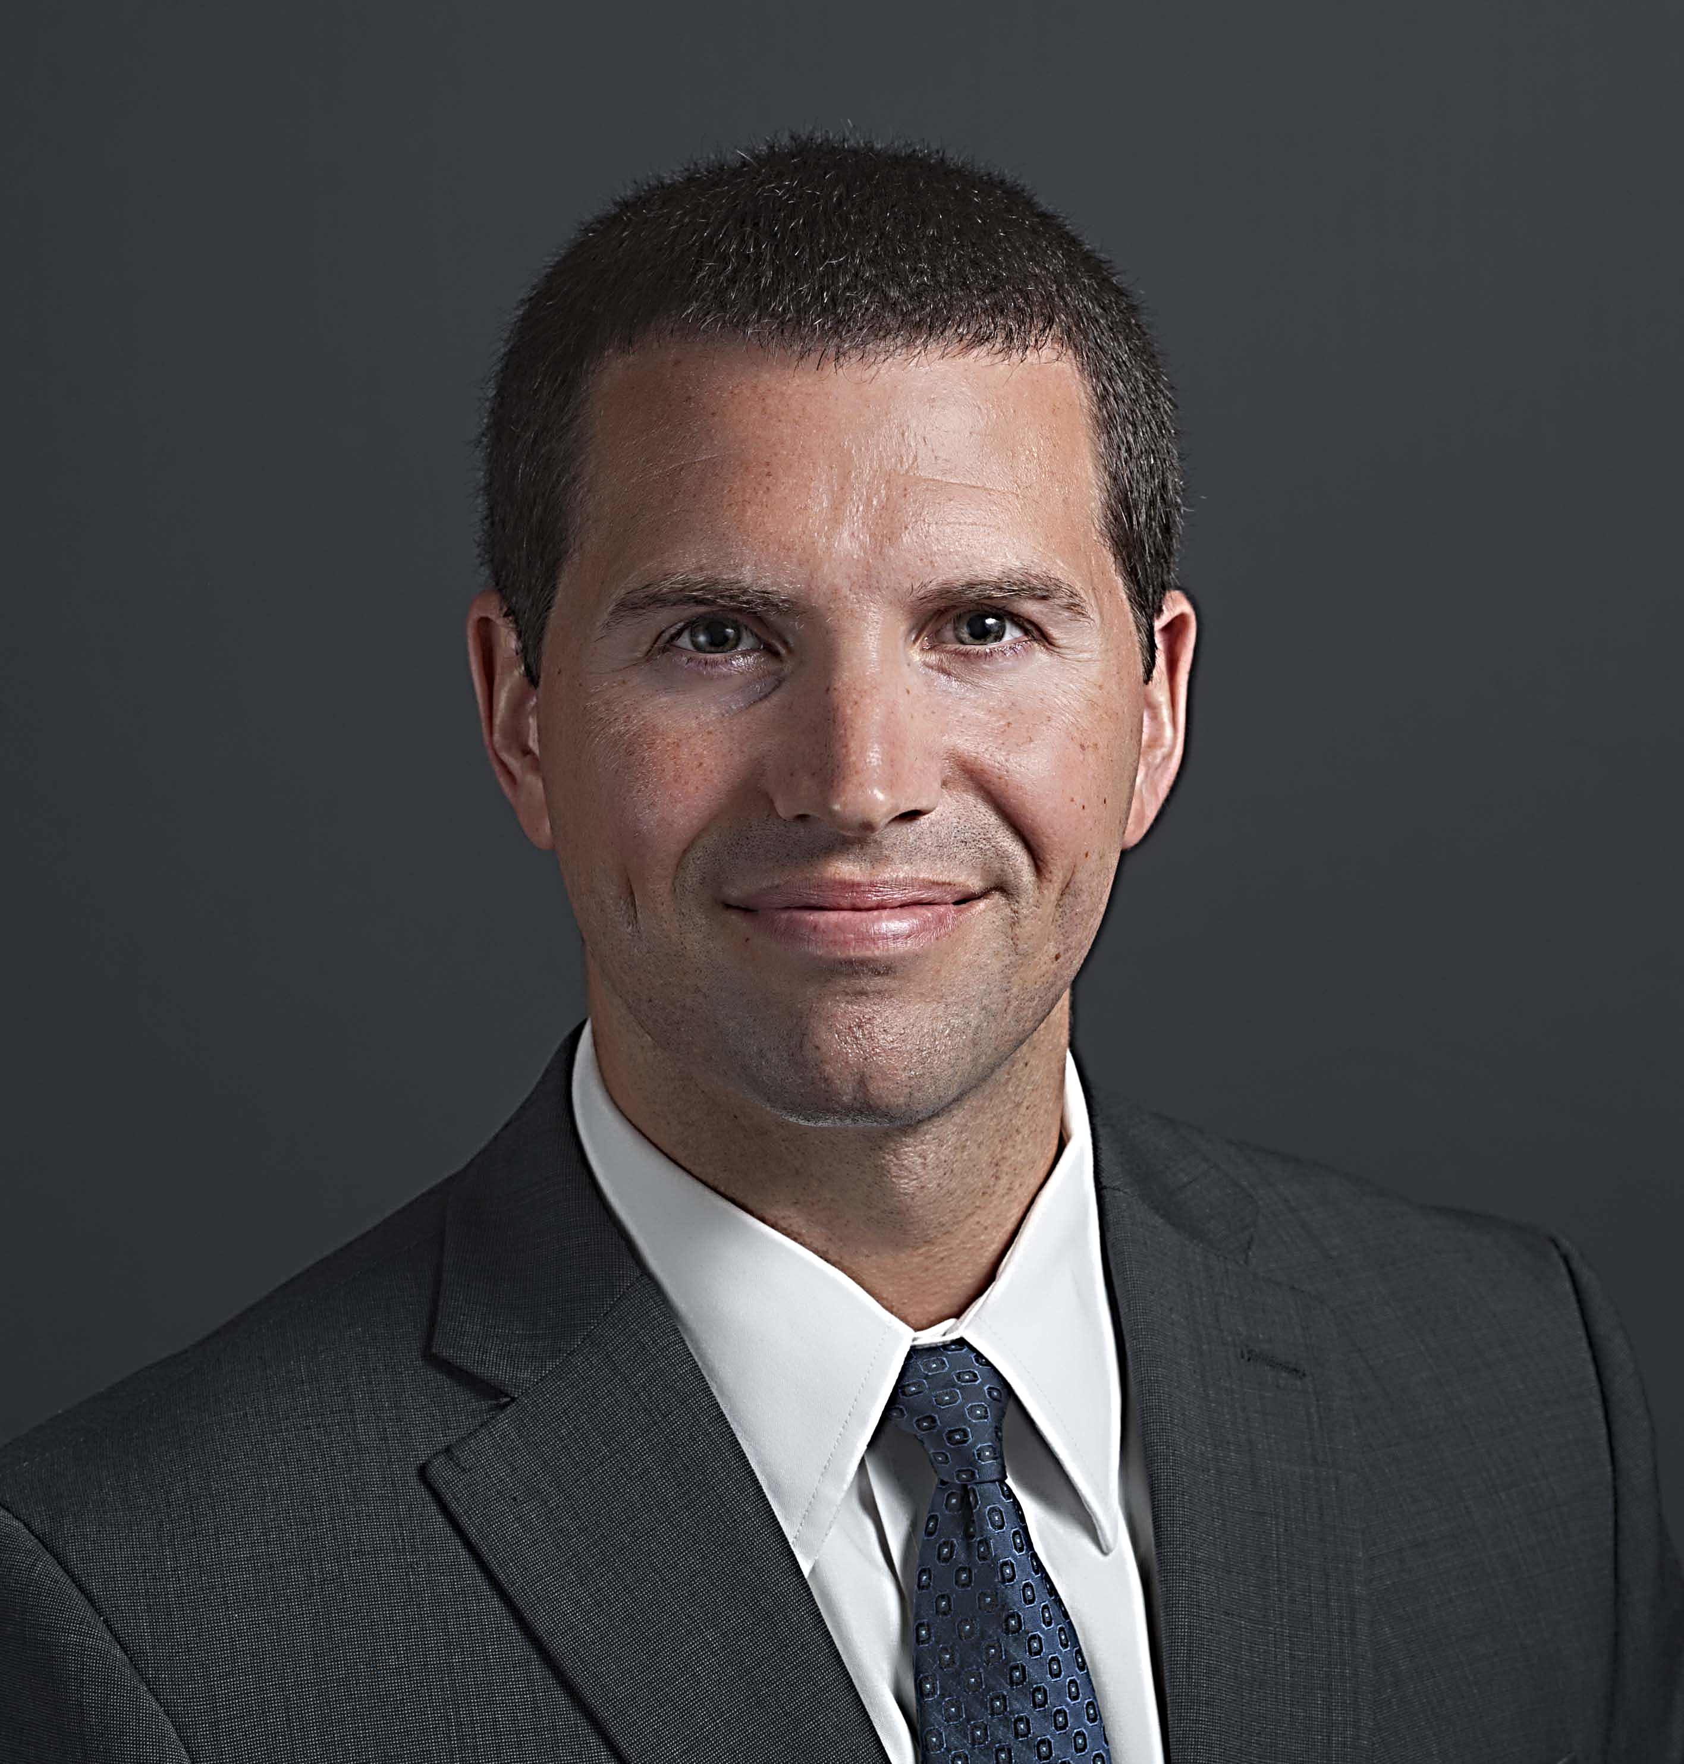
Presenter
Cerone F. “Cy” Sturdivant, CISA®
Director | Advisory (Cybersecurity)
Nashville, Tennessee
Cy.Sturdivant@forvis.com
615.988.3596

Slide 3
Agenda
Update on Cybersecurity Trends & Statistics
Discuss Current Cybersecurity Threats & Concerns
Discuss Industry Best Practices
Grants Specific Security Considerations
Final Thoughts & Resources
Questions & Answers

Slide 4
Cybersecurity Trends & Statistics

Slide 5
2022 Verizon DBI Report
Ransomware-related breaches increased by 13%, (more than the past five years combined)
Nearly 50% of all system intrusion incidents involved ransomware last year
Ransomware was present in almost 70% of malware breaches in the past year
Supply chain was involved in 62% of incidents this year. Compromising the right partner is a force multiplier for threat actors
82% of the breaches reported involved the use of stolen credentials, phishing, misuse, or human errors. People still play a large role!
Notes:
Timeframe - November 2020 and October 2021.
While supply chain attacks still account for just under 10% of overall cybersecurity incidents, according to the Verizon data, the study authors point out that this vector continues to account for a considerable slice of all incidents each year. That means it's critical for companies to keep an eye on both their own and their vendors' security posture. This could include:

Slide 6
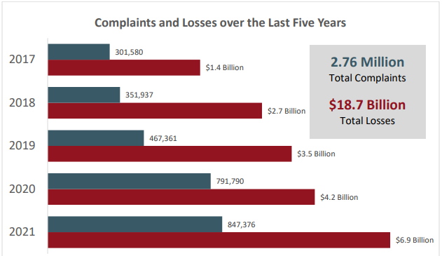
FBI’s IC3 Five Year Statistics
Notes:
FBI’s – Internet Crime Compliant Center 2021 Report – $2.4B lost to BEC

Slide 7
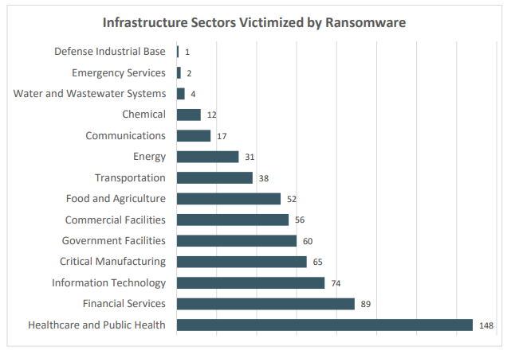
IC3 – Ransomware Fast Facts
**The average downtime for a ransomware incident is 16–21 days**
For 2021, the FBI’s Internet Crime Complaint Center (IC3) received 3,729 complaints identified as ransomware with adjusted losses of more than $49.2 million.
There were 2,474 complaints files in 2020 representing a 66% increase from 2020 to 2021.“2021_IC3Report.pdf”
Notes:
https://www.ic3.gov/Media/PDF/AnnualReport/2021_IC3Report.pdf

Slide 8
IC3 – Business Email Compromise (BEC)
In 2021, the IC3 received 19,954 complaints of Business Email Compromise (BEC)/Email Account Compromise (EAC) complaints with adjusted losses at nearly $2.4 billion.
Note: BEC fraud has cost businesses around the world $43 billion during the period between June 2016 & December 2021.
IC3 Recovery Asset Team (RAT) Guidance
• Contact the originating financial institution as soon as fraud is recognized to request a recall or reversal & a Hold Harmless Letter or Letter of Indemnity
• File a detailed complaint with www.ic3.gov. It is vital the complaint contains all required data in provided fields, including banking information
• Visit www.ic3.gov for updated PSAs regarding BEC trends as well as other fraud schemes targeting specific populations, like trends targeting real estate, pre-paid cards, & W-2s, for example
• Never make any payment changes without verifying the change with the intended recipient; verify email addresses are accurate when checking email on a cell phone or other mobile device
Notes:
BEC/EAC is a sophisticated scam targeting both businesses and individuals performing transfers of funds. The scam is frequently carried out when a subject compromises legitimate business email accounts through social engineering or computer intrusion techniques to conduct unauthorized transfers of funds. The scheme has evolved from simple hacking or spoofing of business and personal email accounts and a request to send wire payments to fraudulent bank accounts. These schemes historically involved compromised vendor emails, requests for W-2 information, targeting of the real estate sector, and fraudulent requests for large amounts of gift cards. Now, fraudsters are using virtual meeting platforms to hack emails and spoof business leaders’ credentials to initiate the fraudulent wire transfers. These fraudulent wire transfers are often immediately transferred to cryptocurrency wallets and quickly dispersed, making recovery efforts more difficult.
They do so by compromising an employer or financial director’s email, such as a CEO or CFO, which would then be used to request employees to participate in virtual meeting platforms. In those meetings, the fraudster would insert a still picture of the CEO with no audio, or a “deep fake” audio through which fraudsters, acting as business executives, would then claim their audio/video was not working properly. The fraudsters would then use the virtual meeting platforms to directly instruct employees to initiate wire transfers or use the executives’ compromised email to provide wiring instructions.

Slide 9
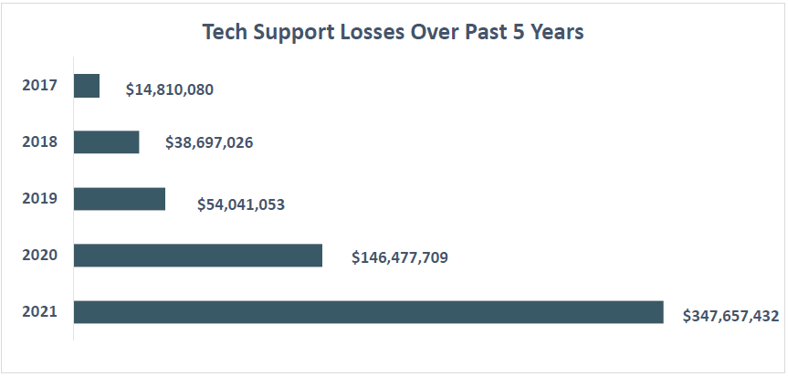
Tech Support Fraud
In 2021, the IC3 received 23,903 complaints related to Tech Support Fraud from victims in 70 countries.
The losses amounted to more than $347 million, up 137% since 2020.
Note: 60% of victims were over 60 years old & accounted for $238 million of the total losses.
Red Flags – Scammers often impersonate well-known tech companies, offering to fix non-existent technology issues or install fraudulent software, often requesting wire transfers to overseas accounts or large amounts of prepaid cards.
Notes:
The scammer’s intention is to quickly establish a relationship, endear himself/herself to the victim, gain trust, and eventually ask for money. Scam artists often say they are in the military, or a trades-based industry engaged in projects outside the U.S. That makes it easier to avoid meeting in person—and more plausible when they request money be sent overseas for a medical emergency or unexpected legal fee.
Grandparent Scams also fall into this category, where criminals impersonate a panicked loved one, usually a grandchild, nephew, or niece of an elderly person. The loved one claims to be in trouble and needs money immediately.

Slide 10
Cybersecurity Threats & Impacts

Slide 11
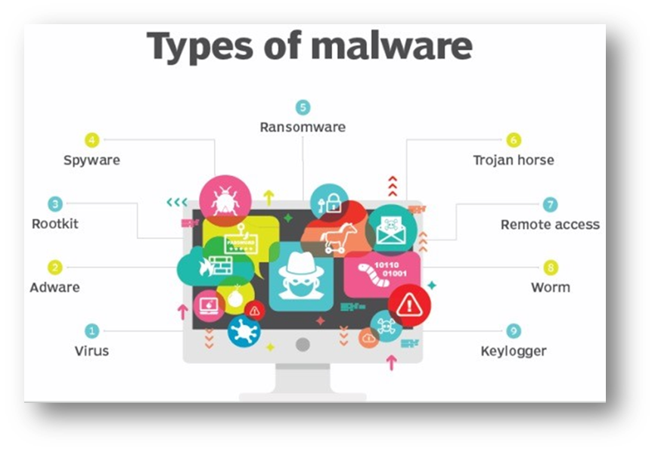
Most Common Cybersecurity Threats
Social engineering attacks – phishing
Business email compromise
Supply chain attacks!
Malware/destructive malware
*Ransomware*
Remote access
Keyloggers
Cloud applications/web apps
Root causes of cyberattacks: Inadequate training, ineffective patch management, weak privileged access controls, & unmonitored detection systems

Slide 12
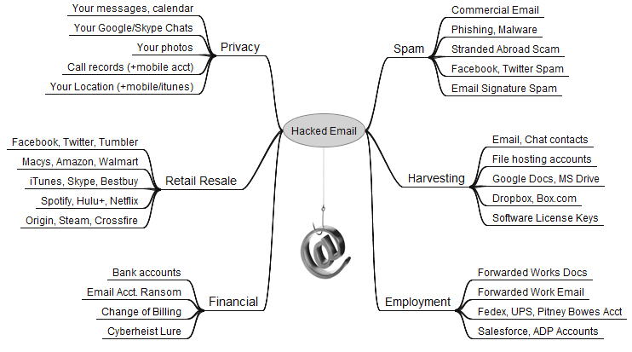
The Ultimate Gateway – Email
Notes:
Do you really know how far email goes and how much it touches…

Slide 13
Breach Impacts
Damage to brand
Deceptive or unfair trade charges
Regulator
scrutiny
Reputation Risk
Regulatory response
Cybersecurity Event
Negative publicity
!
Damaged employee relationships
Regulatory sanctions/MOUs
Financial loss
Regulatory fines
Damaged third-party relationships
Operational Disruption
Diversion of
resources
Costs of recovery
Legal
liability
Lost productivity

Slide 14
Breach Detection & Expense
You can’t afford to ignore cybersecurity – Especially now!
In the U.S., average total cost of a data breach is $9.44 million ($9.05)
Average cost per lost or stolen record is $164 ($161)
Companies with an incident response team & extensive testing of their response plans
saved over $2 million compared to those who did not.
Average total cost of a data breach in PS
$2.07 million ($1.93)
Mean time to identify a breach
207 days
Mean time to contain
70 days
Source: Ponemon Institute 2022 Cost of Data Breach Study

Slide 15
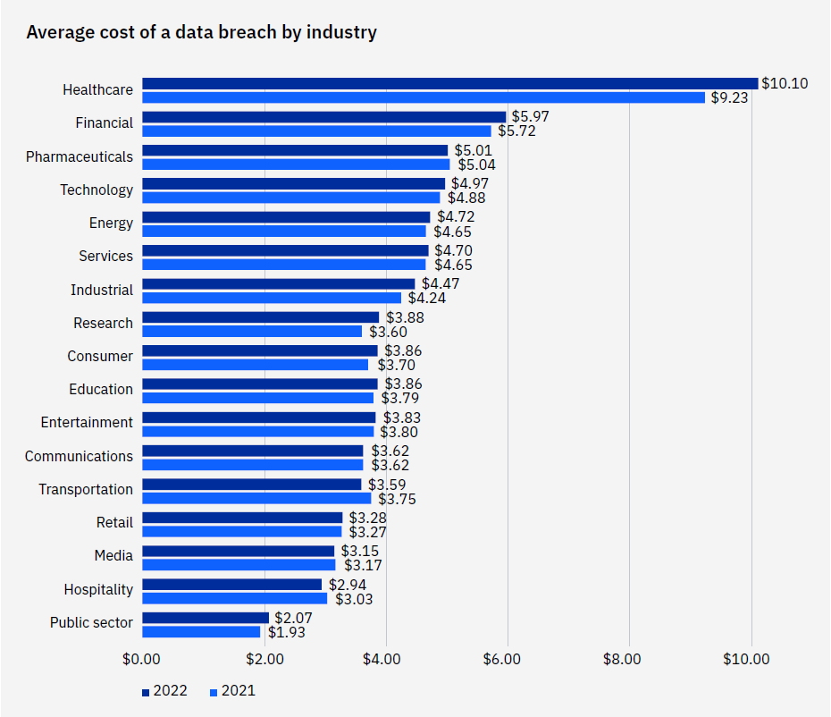
Breakdown
by Industry
Source: 2022 Cost of a Data Breach Report

Slide 16
Industry Updates & Best Practices

Slide 17
Key Considerations: Focus on Governance Controls
Maintain a strong information security program
Maintain a strong incident response program
Ensure business continuity/DR & vendor management policies & procedures address cybersecurity
Consider how cybersecurity insurance should fit into your risk management program
Ensure cybersecurity awareness training is performed regularly (educate & motivate)
Engage in Information Sharing & Analysis Center (ISAC) or other information sharing forums – filter reports based on each employees’ role
Perform frequent cyber risk assessments, penetration tests, vulnerability assessments, & IT control audits

Slide 18
Key Considerations: Focus on Technical Controls
Use multifactor or two-factor for O365, VPN, remote sessions, & privileged access
Track, report, independently test, & update security patches based on a risk priority schedule (Microsoft & non-Microsoft patches)
Maintain strong passwords for your network accounts and email
Enforce application whitelisting controls & remove unauthorized applications
Remove local administrator rights to reduce malicious software installs
Tune existing security tools – web content, email filtering, end point, etc.
Deploy cloud-based security software & end-point protection (SentinelOne, Crowdstrike, Windows Defender, etc.)

Slide 19
Key Considerations: Technical Controls
Implement strong cloud-based data loss prevention controls
Use security information & event management (SIEM) tools with “defense in depth” approach
Block malicious email attachments to prevent compromise
Ensure data encryption is enforced to protect confidential data
Segment internal networks to isolate critical systems
Be aware of insider threat – layoffs, disgruntled, etc. Think zero trust!
Air-gap your backups to keep them out of reach of an attack
Make your air-gapped backups immutable!

Slide 20
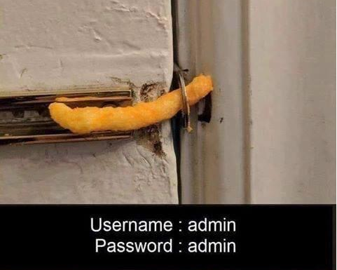
What Cybercriminals See, if You Fail!

Slide 21
Grants Specific Security Considerations

Slide 22
IT Security and Grants Management Considerations
Does your organization have an IT security policy?
Protect PII (Personally Identifiable Information)
Restrict access to necessary parties
Identify acceptable technology usage
Has your organization conducted an IT risk assessment?
Identify the risks and remediate the gaps

Slide 23
IT Security and Grants Management Considerations
Have you backed up your data?
Under the terms of your Wisconsin grant agreement, data files related to the grant must be retained for a period of five (5) years after the period of performance ends (until 12/31/2029)
Includes procurement data/documentation
Requirements apply to agreements terminated prior to the end date
Supersedes Uniform Guidance
Note that the data and records retention requirement, under your Wisconsin grant agreement, is longer that what is required were the Uniform Guidance to apply. (2 CFR Part 200.334 requires that grant records be retained for a minimum of three (3) years after the close out of the grant, or three (3) years from the date of audit resolution.)
Uniform Guidance retention requirement does not apply to your Wisconsin grant agreement

Slide 24
Final Thoughts & Conclusion

Slide 25
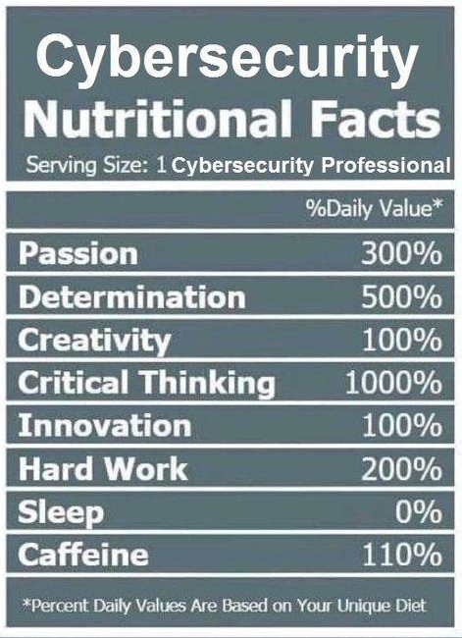
Cybersecurity Nutrition
A strong cybersecurity culture & overall program is a must going forward!
Are you taking care of your “cybersecurity health”?
When the Board & key executives emphasize a Cybersecurity culture—& implement programs that align with that culture—it's much easier to get buy-in from all stakeholders across your organization.
Notes:
Use a platform for testing! KnowBe4, PhishMe,

Slide 26
Don’t Be Like This!

Slide 27
Other Resources
Info Risk Today – https://www.inforisktoday.com/
Security Week – https://www.securityweek.com/
Dark Reading – https://www.darkreading.com/
The Top Cyber Threat Intelligence Feeds – https://thecyberthreat.com/cyber-threat-intelligence-feeds/

Slide 28
Thank you!

