Slide 1
Payment Requests and Financial Monitoring
Presented in conjunction with:
Wisconsin Department of Administration (DOA)
Wisconsin Economic Development Corporation (WEDC)
March 9, 2023

Slide 2
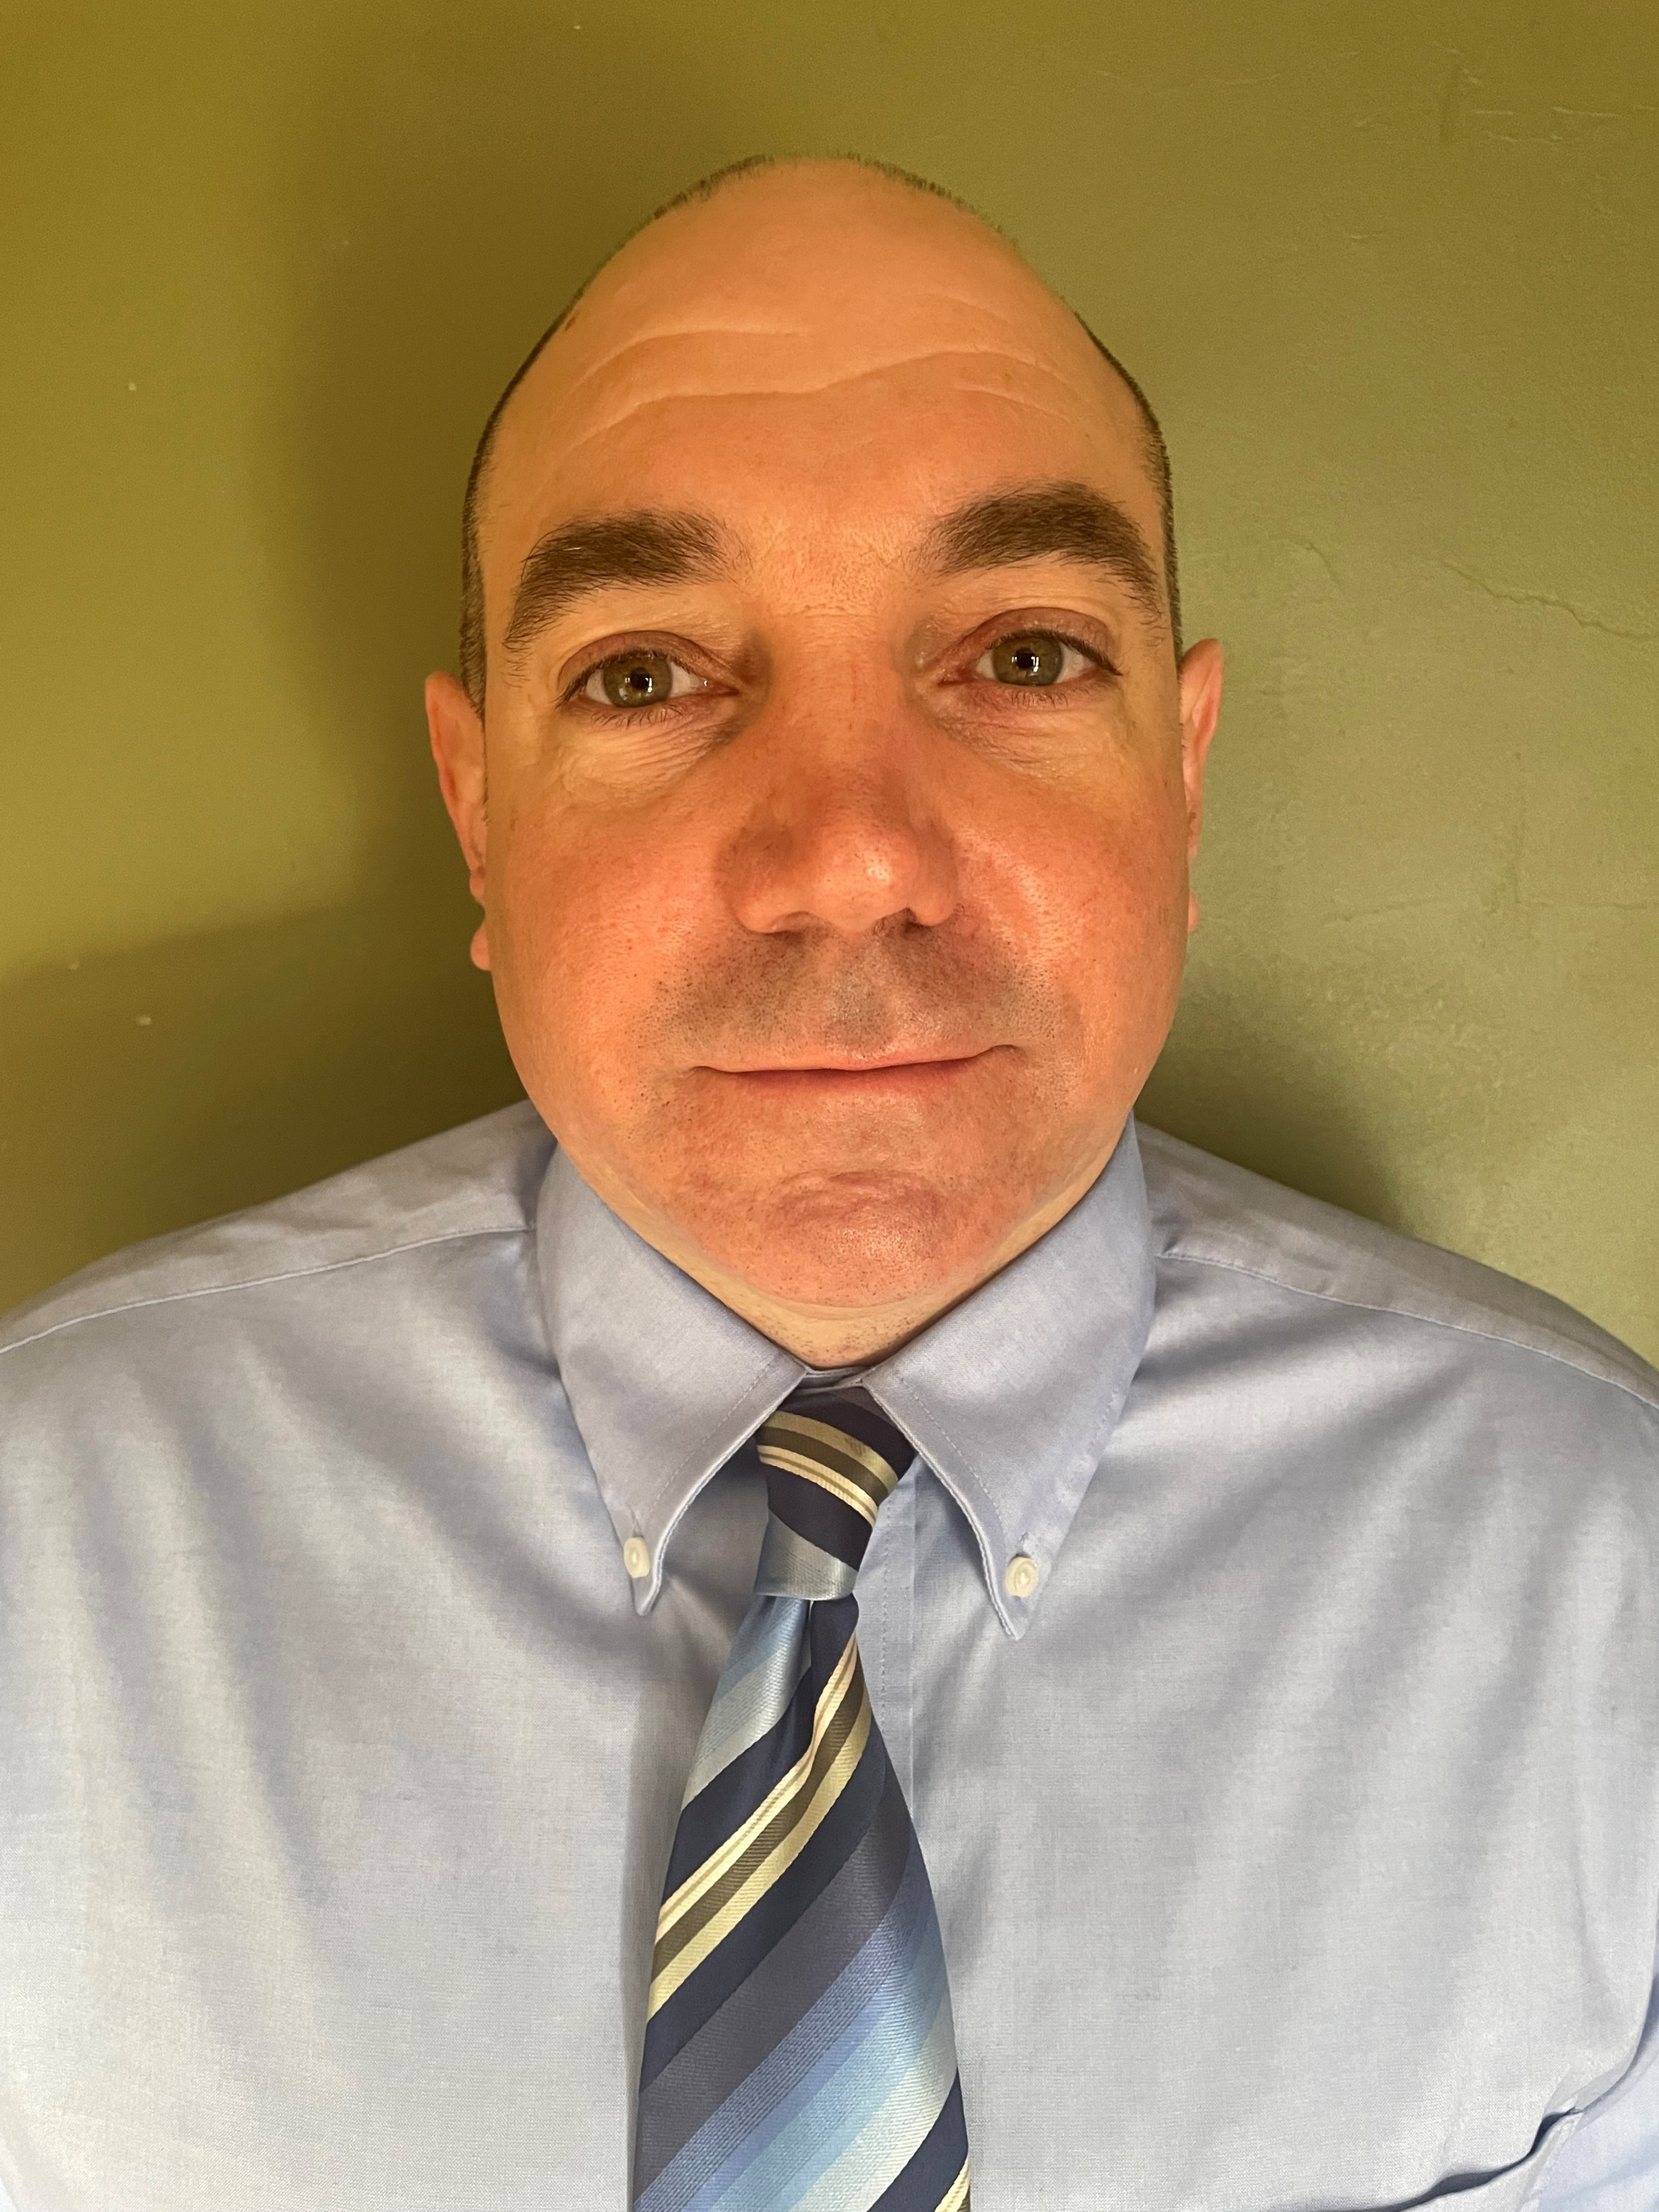
Presenters
Richard Rydecki
Evan Masters
Deputy Administrator, Division of Enterprise Operations, Wisconsin Department of Administration
Consultant, National Grants Management Services

Slide 3
Legal Disclaimer
FORVIS presenters are not providing legal advice. This presentation is meant to be an overview of Payment Requests and Financial Monitoring for the Wisconsin DOA Program Grantees and should not be taken as legal guidance from DOA, WEDC or FORVIS.
Program Grantees should direct specific questions to the appropriate program inbox that they use to correspond with DOA representatives.

Slide 4
Today’s Topics
DOA Grantee Semiannual Report and Payment Request Process
Financial Monitoring Best Practices

Slide 5
DOA Grantee Semiannual Report and Payment Request Topics
1. Report Preparation Items to Consider
2. Sequence of Requests
3. Completing the Report and Payment Request
4. Closing
5. Questions?

Slide 6
When to Submit the Semiannual Report and Payment Request
Submit Initial Payment Request within 30 days of Grant Agreement execution
Subsequent payment requests are submitted in December and June of each year
If Payment Request Form is completed properly, payment is generally made approximately 30 days after submission
Payment Requests can be for reimbursement of costs and/or as an advance to cover the next six months’ expenses

Slide 7
Sequence of Requests
GRANT AGREEMENT
AMENDMENT
Memorializes both the purpose of the project(s) and the expectations of Grantees and the Department of Administration.
If there are changes to the Scope of Work, Budget, or Timeline, an Amendment needs to be completed prior to making changes.
INITIAL PAYMENT REQUEST
PAYMENT REQUESTS
Can occur immediately after Grant Agreement is signed and should be submitted within 30 days of grant agreement execution.
Due every six (6) months. Payments are processed within approximately 30 days of submission.

Slide 8
Getting Ready
Have resources available when preparing your form for submission
Minimize errors in completing the form to avoid issues that may delay payment
Contact program staff with any questions you have about the form or process

Slide 9
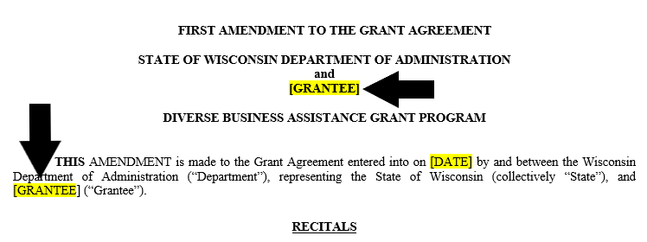
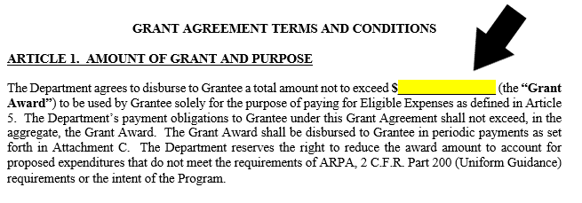
Preparing to Submit Your Semiannual Report and Payment Request
Check your initial grant agreement to verify:
Grantee name
Total award amount
Project ID
Determine a contact person from your organization in the event Program Staff have questions while processing your request
Have previous payment request(s) available for reference, if applicable

Slide 10
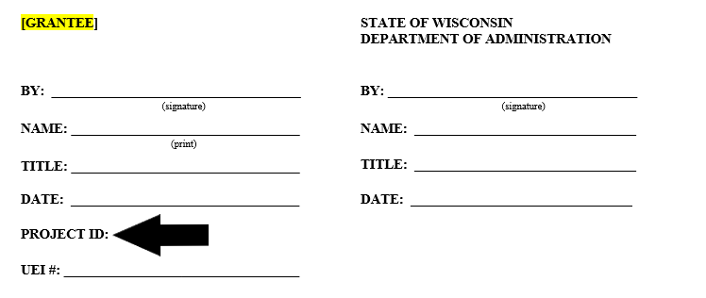
Preparing Cont.
Check your initial grant agreement to verify:
Grantee name
Total award amount
Project ID
Determine the contact person from your organization in the event Program Staff have questions while processing your request
Have any payment request(s) available for reference, if applicable
Links to the Payment Request Form are found on the appropriate Program website

Slide 11
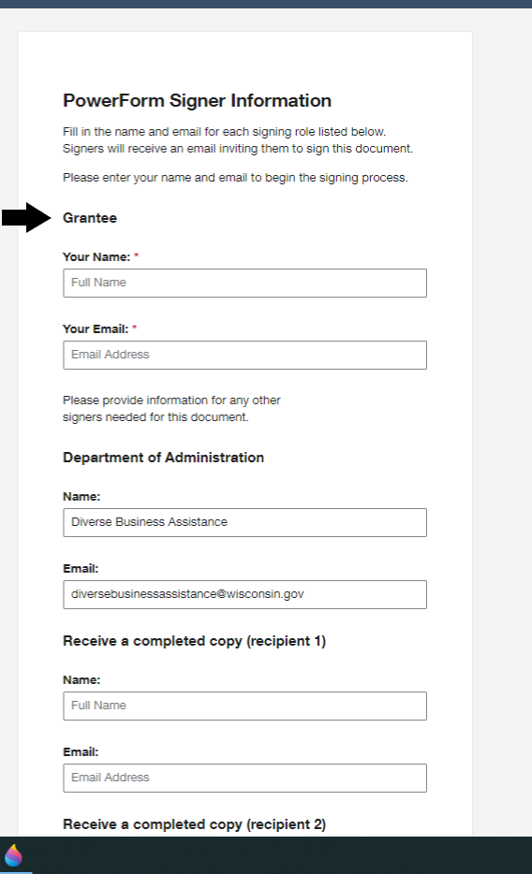
Section 1: DocuSign
The point of contact for the organization should submit this form
If your Point of Contact has changed, email the program mailbox to inform DOA
Submitter must be someone authorized to act on the organization's behalf/able to legally bind the organization

Slide 12
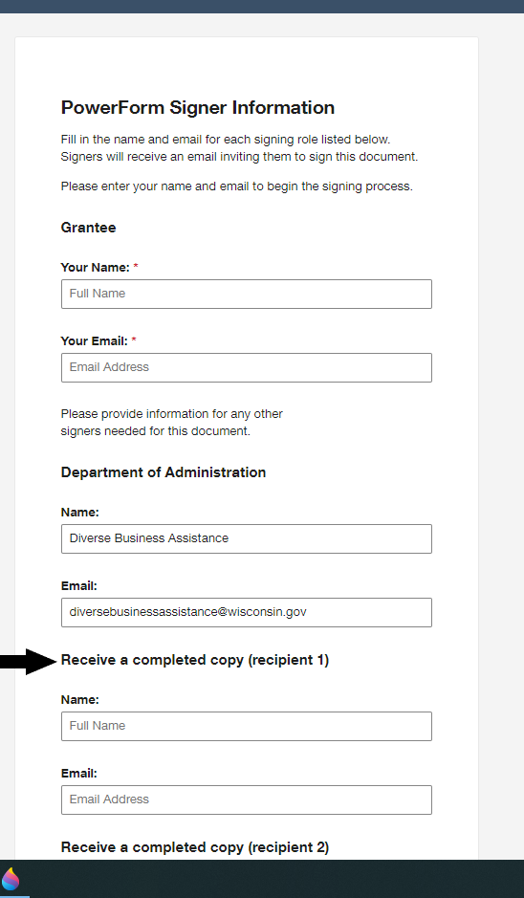
DocuSign, cont.
Note: a courtesy copy will be sent to the person who filled out the form once it is submitted to DOA
If you would also like a copy of the completed document, provide contact info in the “Receive a completed copy” section
The completed copy will not be sent until after DOA Program staff have finished their review and officially approved the Payment Request
It may take several weeks to receive the completed copy after approval
Once complete, scroll down and select the yellow “Begin Signing” button

Slide 13
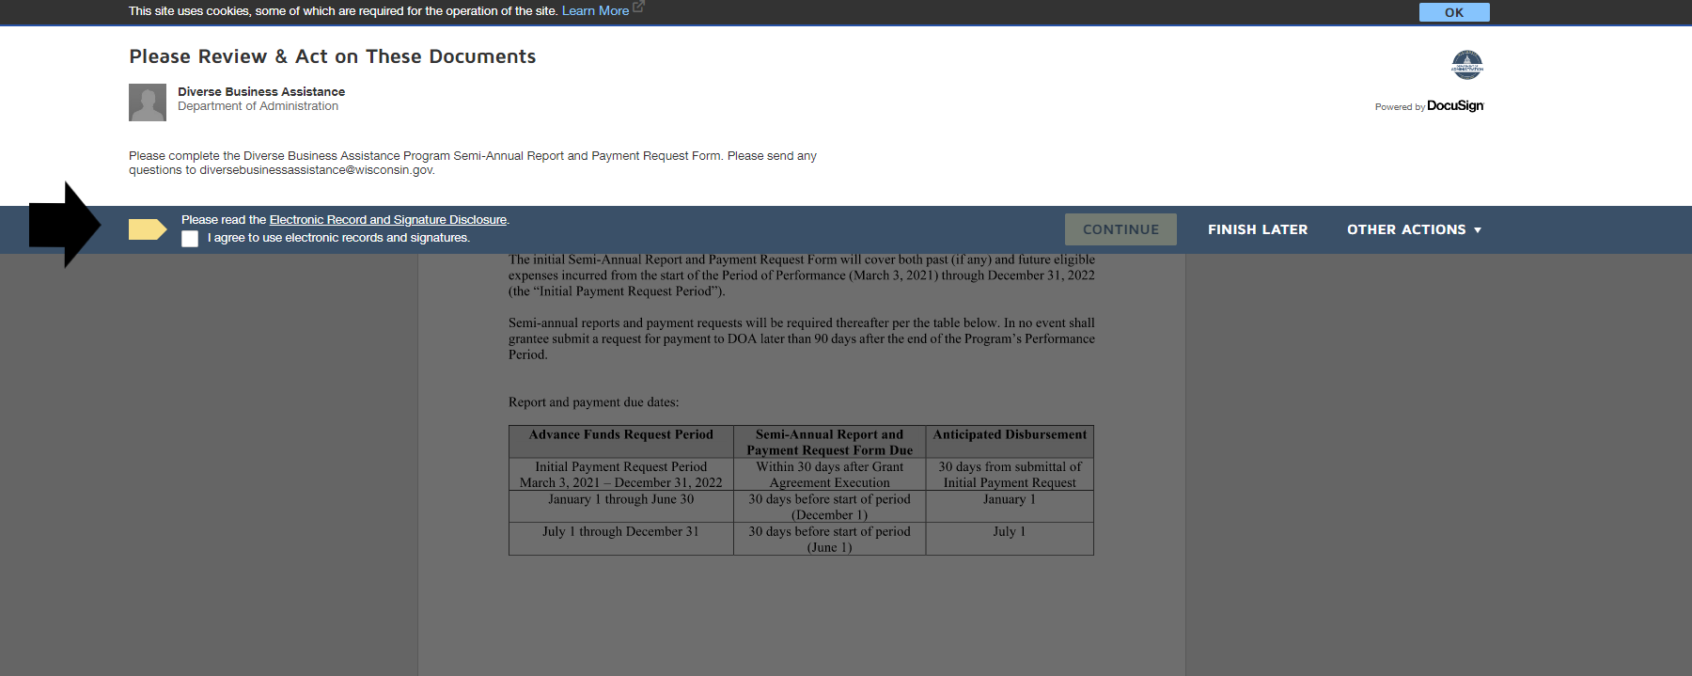
DocuSign Disclosures
Prior to gaining access to the DocuSign document, you must review and agree to the Electronic Record and Signature Disclosures
Check the white box and select “Continue” once you have reviewed the disclosure

Slide 14
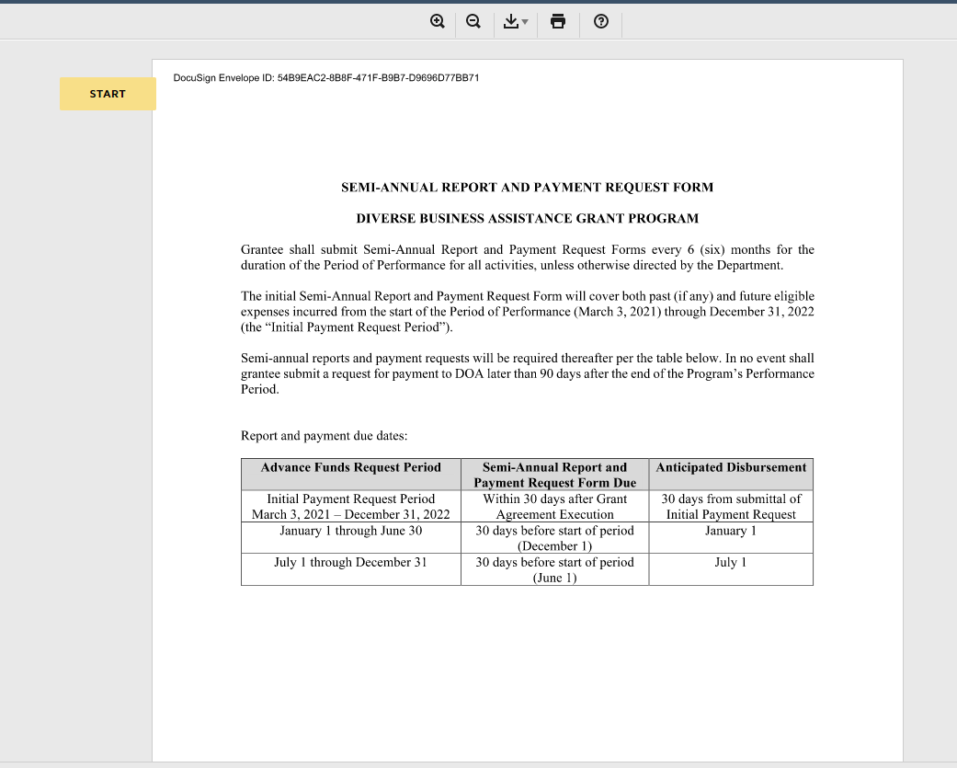
Semiannual Report Deadlines
The first page of the Semiannual Report and Payment Request Form explains the timelines for submission and what information is required
Click the yellow "Start" button to begin the process. Required fields will have a "Fill" Tab.

Slide 15
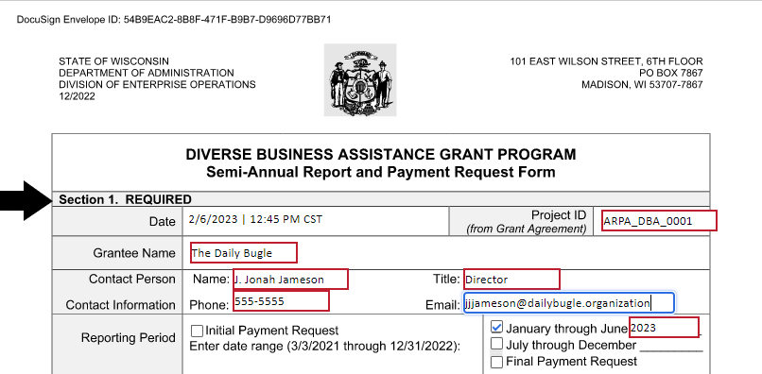
Section 1, Header
Project ID and Grantee Name should come from your Grant Agreement
Select the correct six-month period for the payment request
Note: if you need to submit an initial payment and an additional payment request, submit each separately
Please contact program staff if you have any questions
ARPA-DBA-001
For Equitable Recovery Grantees Only:

Slide 16
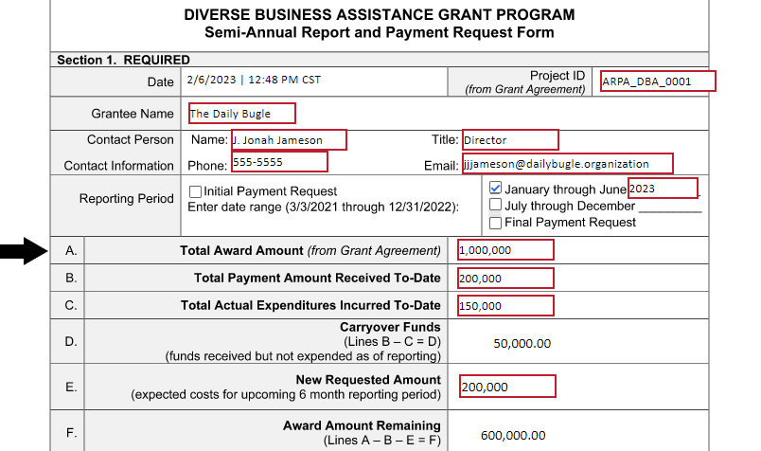
Section 1, Line A
Line A should come directly from your Grant Agreement
Equitable Recovery grantees with multiple grant IDs should submit separate payment requests for each ID
Line A should reflect the grant amount dedicated to each category.
ARPA-DBA-001

Slide 17
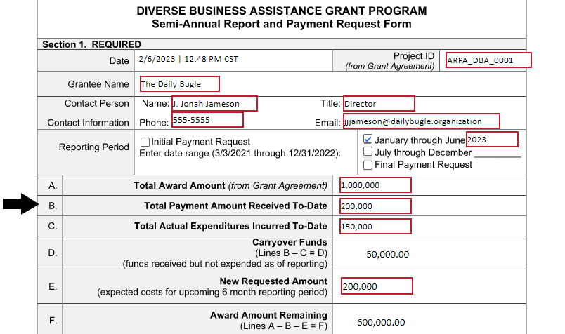
Section 1, Line B
ARPA-DBA-001
List the total payment amount received from previous submissions
Line B must equal the total of all amounts previously received
If this is your initial payment request the amount will be zero

Slide 18
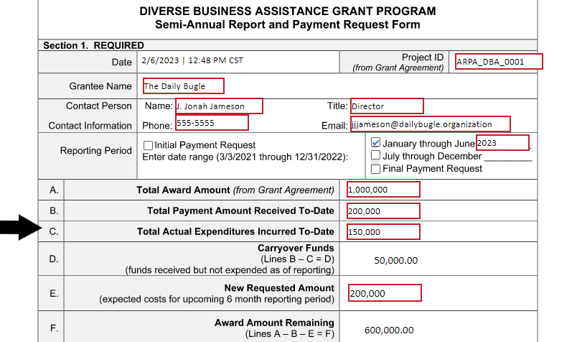
Section 1, Line C
ARPA-DBA-001
Line C should match the total amount your organization has actually spent on allowable expenses at the time of the payment request
Accounting system should track budget versus actual expenditures

Slide 19
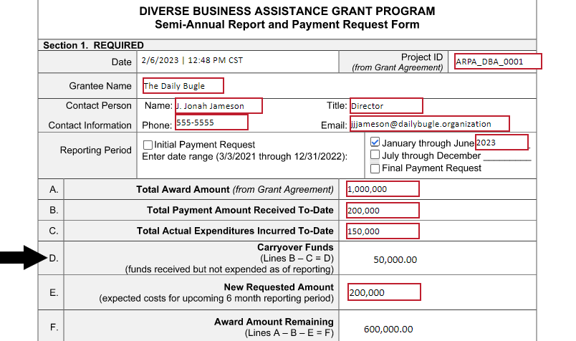
Section 1, Line D
ARPA-DBA-001
Carryover funds are funds that are received but have not been expended at the time of the request
DocuSign automatically calculates this information by subtracting Line B from C
If expenditures to date exceed the amount previously received, this will appear as a negative number

Slide 20
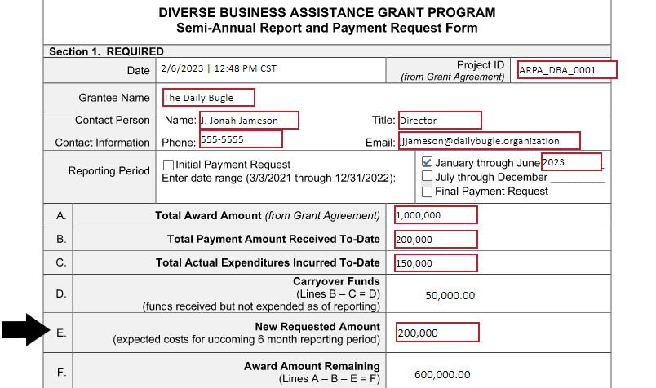
Section 1, Line E
ARPA-DBA-001
Line E is the amount your organization is requesting for the current payment period
Expected costs for the upcoming six-month reporting period
Detailed accounting of funds will be required in Section 2, Budget

Slide 21
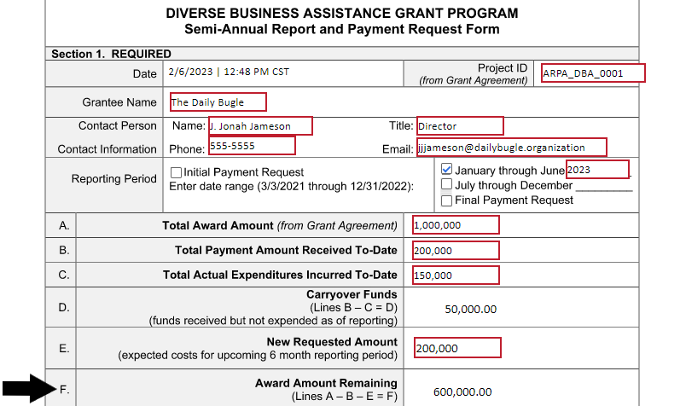
Section 1, Line F
DocuSign will automatically calculate this information
A – B – E = Award amount remaining
ARPA-DBA-001

Slide 22
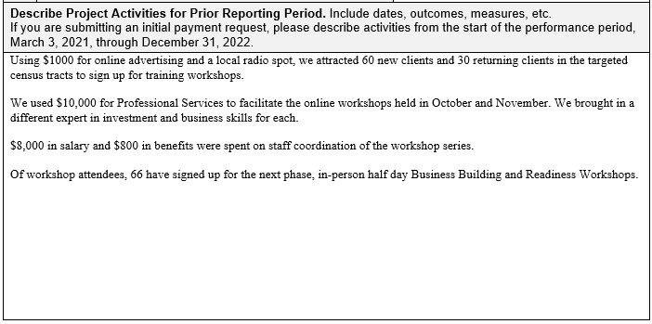
Section 1, Narrative 1
Have activities met the scope and objectives of the project?
Were there any major milestones achieved or project timelines met during this period?
Provide numbers, demographics, specific dates, and deliverables
Narrative here must be consistent with Scope of Work
Explain the reason for any carryover funds including when Grantee expects to spend these funds
Please refer to your grant agreement, past payment requests, and grant application for reference

Slide 23
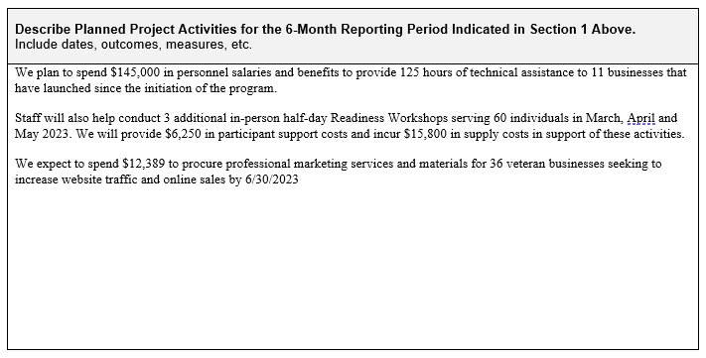
Section 1, Narrative 2
Are there any timelines or milestones that will be achieved within the next six months?
What activities will the organization undertake to achieve these milestones or goals?
Provide Specifics
Note: If your grant has additional funds allocated to it from another source, explain how you will minimize the risk of duplicating funds from this payment request

Slide 24
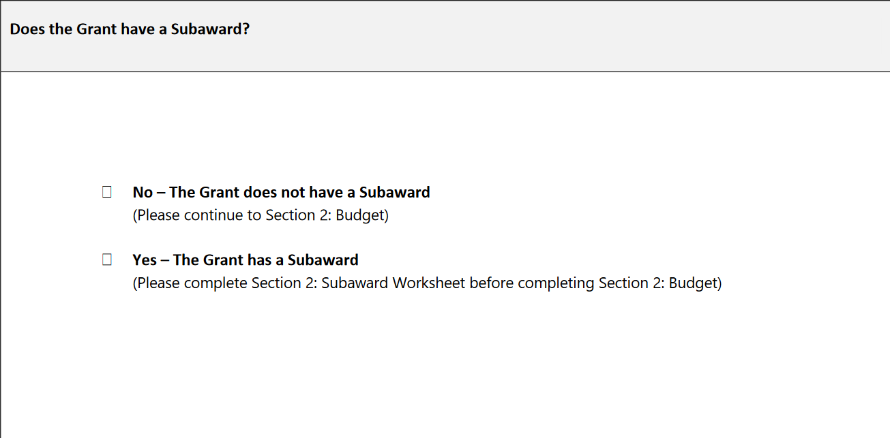
Subawards (Program Dependent)
Subawards are only an option for grantees in three programs: NIF, DBI and DBA
DBA and DBI participants: contact program staff to receive subaward worksheet
NIF grantees see this screen and have the choice to select the subaward option
If your organization has subawardees, select “yes” and complete the subaward worksheet
Reminder: Your organization is responsible for ensuring that subawardees are compliant with all laws, rules, and regulations of ARPA and the State of Wisconsin

Slide 25
Section 2: Subaward Worksheet
Grantee must complete this portion of the request form if you have a subaward
Worksheet should only have information that pertains to the subaward
Column 1: Matches the initial or amended Grant Agreement budget
Column 2: Includes total funds for each line item of all previous payment requests
Column 3: Actual total expenditures related to the subaward(s)
Column 5: Includes the new payment request amount for each cost category
Note: the combined total amount of Column 5 and the total amount of Column 2 should not exceed Column 1

Slide 26
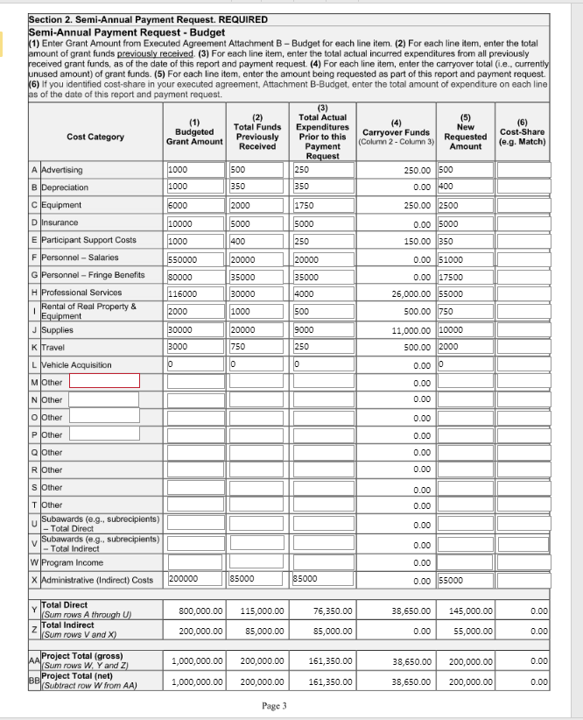
Section 2, Budget
Column 1: Matches to totals listed in Attachment B of the Grant Agreement
If an amendment to the budget has been approved by the DOA, use the information from the amended budget
Column 2: Enter total amount of funds per cost category received from previous payment requests, even if those funds have not been disbursed yet
Column 3: Lists the actual total expenditures for each cost category incurred as of the date of payment request
If your organization’s signed Grant Agreement contained cost-share amounts, enter the amounts as an aggregate per cost category in Column 6, as of this payment request

Slide 27
Tips for Completing the Budget Table
Section 1:
This example shows Column 5 with an incorrect match to Section 1, Line E
DocuSign does not validate these numbers; it calculates based on what you reported on the form
Review for typos and incorrect totals in Columns 1 and 2
Ensure that totals for each budget line in Columns 2 and 5 do not exceed the amount in Column 1 when added together
Budget table:

Slide 28
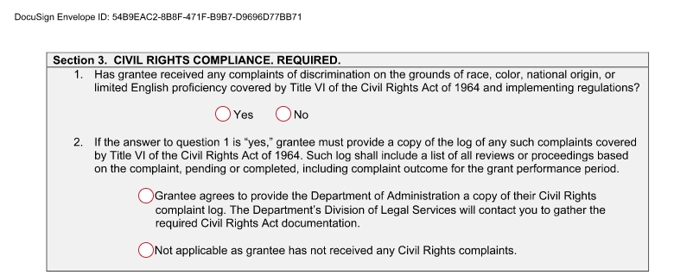
Section 3
If your organization has received any complaints of discrimination, you must inform DOA Program Staff by checking “Yes”
You will be contacted by the Division of Legal Services for a copy of the complaint log and other relevant documentation
Includes Settlements
If you have previously provided a complaint log, but have not received any new complaints, you must still check "Yes," then inform Legal Services of the status of the complaint(s) and provide any further required documentation

Slide 29
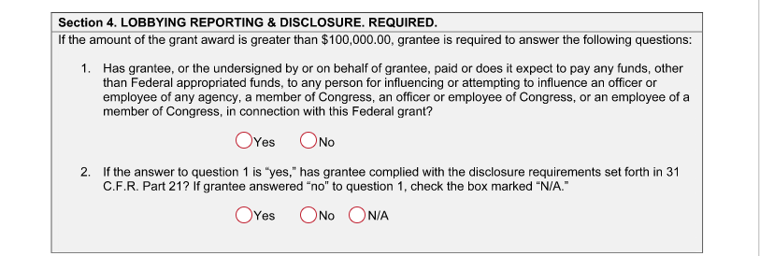
Section 4
Lobbying is not an eligible expenditure for ARPA funds
Section 4 on Lobbying must be completed for all awards greater than $100,000
Depends on the award amount, not Grantee's lobbying status

Slide 30
Section 5
Organizations that receive an award in one of these programs are subject to financial and other program monitoring
Organizations that have undergone or will undergo an audit, Single Audit, or otherwise, will be required to submit this information to DOA Program staff
Organizations that expend $750,000 or more in a single fiscal year are required to have a certified annual audit performed utilizing Generally Accepted Accounting Principles (GAAP) and Generally Accepted Auditing Standards (GAAS) and provide it to DOA
Regardless of the amount of the award organizations expend in a single fiscal year, if it conducts an audit of its financial statements, it must provide a copy of the report to DOA within 30 days of receiving the report
Contact program staff with any questions

Slide 31
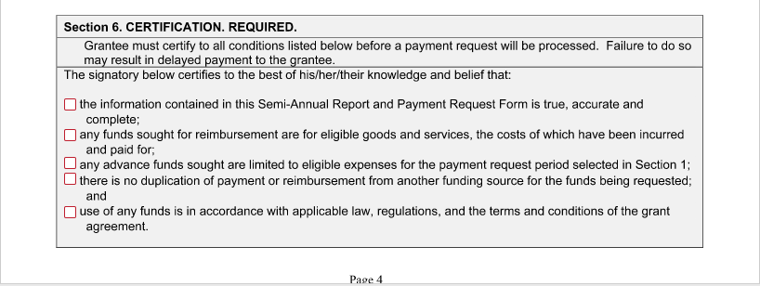
Section 6
Please read thoroughly and attest to the truth of the above statements
If, at any point, these certifications are discovered to be untrue, grantee may be required to repay award funds

Slide 32
Section 7
Cannot process request without a signature
By signing, your organization acknowledges that it is adhering to the requirements imposed by the federal government and DOA to access ARPA funding
Signatory must be an authorized representative of the organization

Slide 33
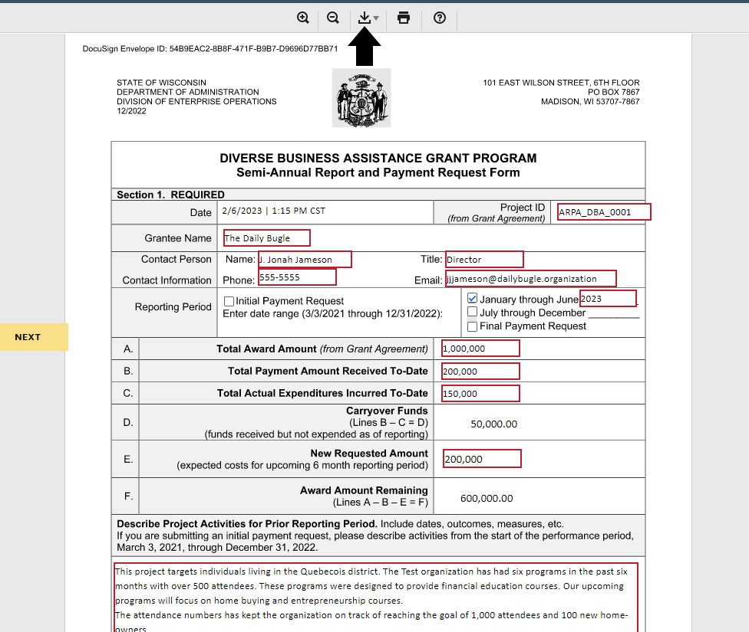
Download a Copy
Once the document has been reviewed and completed by DOA Program Staff, your organization will receive a signed copy if you provided contact information on the first page
Grantee can download a copy of what you entered into DocuSign using the download button (shown by the black arrow on the image)
Grantee can use this copy for reference in submitting future payment requests and to troubleshoot any issues with processing your request
ARPA-DBA-001

Slide 34
Close-Out Procedures
If you no longer have award funds to spend, program staff will reach out with close-out procedures and instructions
After the grant is closed out, you must retain any records related to the ARPA-funded program for a period of five (5) years from the end of the performance period

Slide 35
Program Emails
PROGRAM | EMAIL
Equitable Recovery Program | EquitableRecovery@wisconsin.gov
Diverse Business Assistance | DiverseBusinessAssistance@wisconsin.gov
Diverse Business Investment | DiverseBusinessInvestment@wisconsin.gov
Neighborhood Investment Fund | NeighborhoodInvestmentFundProgram@wisconsin.gov
Healthcare Infrastructure Capital | DOAHealthcareInfrastructureGrantProgram@wisconsin.gov
Tourism Capital | TourismCapitalGrantProgram@wisconsin.gov

Slide 36
Program Websites
PROGRAM | EMAIL
Equitable Recovery Program | DOA Equitable Recovery Program (wi.gov)
Diverse Business Assistance | DOA Diverse Business Assistance Grant Program (wi.gov)
Diverse Business Investment | DOA Diverse Business Investment Grant Program (wi.gov)
Neighborhood Investment Fund | DOA Neighborhood Investment Fund Program (wi.gov)
Healthcare Infrastructure Capital | DOA Healthcare Infrastructure Capital Grant Program (wi.gov)
Tourism Capital | DOA Tourism Capital Grant Program (wi.gov)

Slide 37
Financial Monitoring of Grant Award Funds
What to Expect?
What is Required?
What to Provide?

Slide 38
Monitoring Process Flow
DOA notifies grant recipient
Recipient provides documentation to DOA
DOA’s independent auditor reviews the documents
Auditors will contact the recipient with any questions

Slide 39
What To Expect?

Slide 40
What to Expect?
Grantees should expect to be contacted for monitoring
1st Letter: Notification of preliminary review of line items in the Grantees Payment Request Form(s)
Typically includes a request for details of expenses that make up the payment line item in Excel and/or additional explanations for variances in budget
Grantees should send all information to the grant program monitoring mailbox
Independent auditors will review the information provided by Grantees and select samples for further testing
2nd Letter: Where independent auditors determine further supporting documentation and explanations are needed, grantees may receive a second notification with details of needed expense information
Auditors will contact you if questions arise and are available to answer monitoring questions via the email address in the letter
40

Slide 41
What is Required?

Slide 42
Monitoring for Compliance
DOA will monitor requirements in the Grant Agreement for compliance
The Grant Agreement allows DOA to access grant financial records at any time
Includes digital files
DOA may also access physical projects subject to the grant

Slide 43
Article 15 of your Grant Agreement
ARTICLE 15. SEGREGATION OF FUNDS AND ACCOUNTING RECORDS
Grantee shall maintain all Grant Award funds in a separate bank account used exclusively for the Grant Award funds or specifically identify the Grant Award funds in a separate internal account used to track all deposits, obligations, and expenditures of Grant Award funds.
Grant Award funds shall be used only for purposes of Eligible Expenses, pursuant to this Grant Agreement.
Grant Award funds shall not be intermingled with funds received from any other source, including but not limited to other grant awards received from the State pursuant to ARPA.
43

Slide 44
Article 16 of your Grant Agreement
ARTICLE 16. FINANCIAL MANAGEMENT SYSTEM
Grantee shall maintain a financial management system that permits the tracing of funds to a level of expenditures adequate to establish that such funds have been used according to all applicable federal statutes and regulations and the terms and conditions of this Agreement.
Grantee shall assure that accounting records for funds received under this Grant Agreement are sufficiently segregated from other agreements, programs, and/or projects.
Grantee shall maintain a uniform double entry, full accounting system and a financial management information system in accordance with Generally Accepted Accounting Principles. Grantee’s chart of accounts and accounting system shall permit timely preparation of reports of Program expenditures as required by the Department.
44

Slide 45
Article 16 (continued)
Grantee’s financial management system shall further provide for the following:
Records that identify adequately the source and application of funds for activities under the Grant Agreement. These records must contain information pertaining to the Grant Award, authorizations, financial obligations, unobligated balances, assets, expenditures, income and interest and be supported by source documentation.
Effective control over, and accountability for, all funds, property, and other assets. Grantee must adequately safeguard all assets and assure that they are used solely for authorized purposes.
The comparison of expenditures with budget amounts for the Grant Award.
45

Slide 46
Article 18 of your Grant Agreement
ARTICLE 18. RECORDKEEPING AND PUBLIC RECORDS LAW
During and for a period of five (5) years from the end of the Performance Period, Grantee shall maintain copies of all documents, including electronic documents and files, relating to Grantee’s participation in the Program, including but not limited to all documents relating to goods and services purchased using Grant Award funds.
The Department and any of its authorized representatives shall have access to and the right at any time to examine, audit, excerpt, transcribe and copy on Grantee’s premises any directly pertinent records and computer files of Grantee involving transactions relating to this Agreement. Similarly, the State shall have access at any time to examine, audit, test and analyze any and all physical projects subject to this Agreement. If the material is held in an automated format, Grantee shall provide copies of these materials in the automated format, or such computer file as may be requested by the State.

Slide 47
What to Provide?

Slide 48
What to Provide?
For the payment lines in the cost categories selected on your Payment Request Form, provide:
Itemized listing of components that equal your payment request(s) by cost category in Excel
Provide this information to the monitoring mailbox within 10 business days of the date of the notification letter

Slide 49
Itemized Listing
Include the following information in Excel:
Invoice listing – vendor name, invoice number, and date
Applicable contracts
Payroll records
Records provided should identify budget versus actual spending for the payment request

Slide 50
Itemized Listing: Cost Share
Provide a listing in Excel of invoices, contracts, payroll descriptions, or other documents that demonstrate how the cost share amount was determined
Details such as vendor name, invoice number, performance date, and invoice date
Should differentiate between actual versus projected spend for the payment request
NOTE: If the itemized listing does not agree to the payment request or cost sharing total, you will need to provide a detailed explanation

Slide 51
Examples of Documents to Provide
The following are examples of potential documents to be provided for various cost categories within ARPA (this list is not all-inclusive):
For goods, provide invoices in appropriate detail to show dates and descriptions. If it is unclear how it relates to the ARPA payment request, please provide that description.
For service items, verify that dates of service or period of service are clearly indicated in the supporting documents
For each area of cost, provide a description as to how the costs relate to ARPA

Slide 52
Examples of Documents to Provide, cont.
For personnel and payroll submissions, provide documentation of payroll and calculations that tie to the submission
Timesheets or other similar documentation must be maintained and provided to DOA, upon request
Describe how payroll amounts were determined and which hours/amounts relate to ARPA grant funding
Grantees must maintain records of the following:
Employee type
Employee number
Rate of pay
Percent of time and/or actual time devoted to the grant project(s)

Slide 53
Document, Document, Document!
Final takeaway: The best way to prepare for financial monitoring is to keep detailed source records of eligible expenditures, as required by the grant agreement
All eligible costs must be sufficiently documented
DOA has the right to seek reimbursement of any grant funds expended in contravention of the grant agreement

Slide 54
Thank you!

