Slide 1
Closeout of DOA ARPA Grants
Presented in conjunction with:
Wisconsin Department of Administration (DOA)
Wisconsin Economic Development Corporation (WEDC)
June 1, 2023

Slide 2
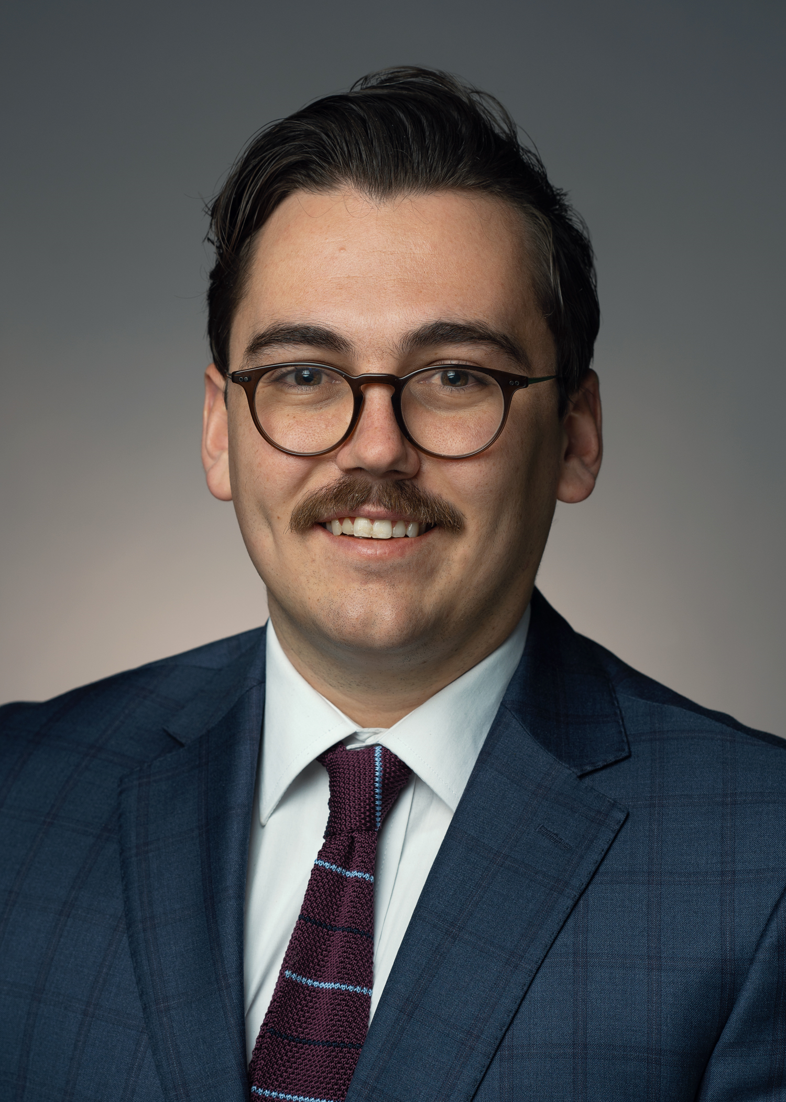
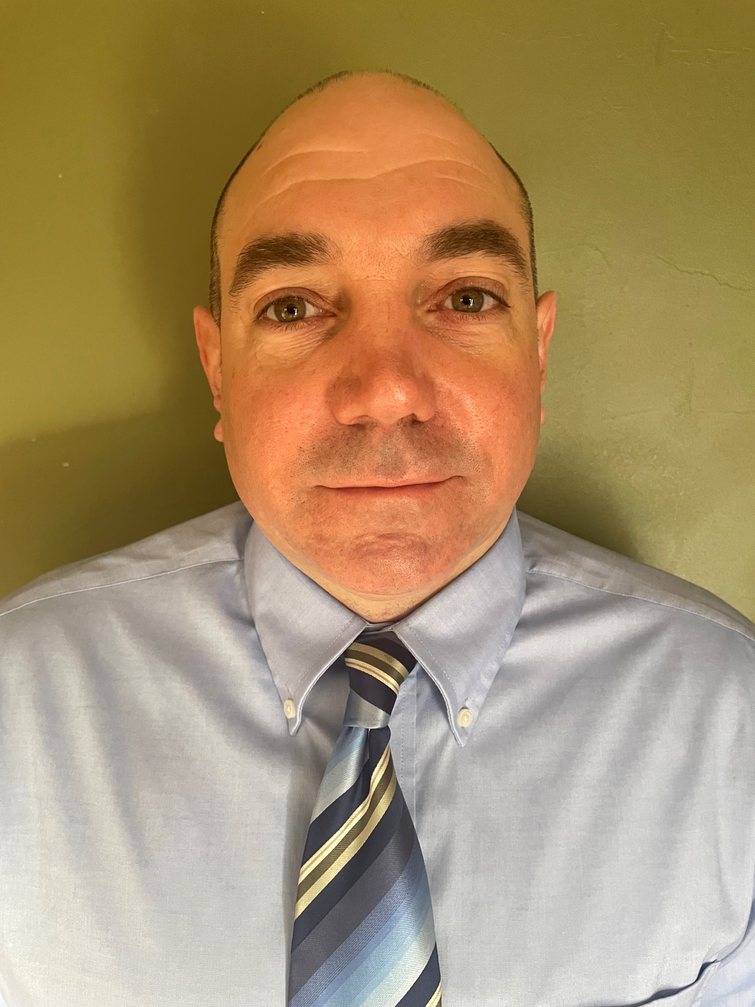
Presenters
Richard Rydecki
Evan Masters
Deputy Administrator, Division of Enterprise Operations, Wisconsin Department of Administration
Consultant, National Grants Management Services

Slide 3
Legal Disclaimer
FORVIS presenters are not providing legal advice. This presentation is meant to be an overview of Closeout processes for the Wisconsin DOA Program Grantees and should not be taken as legal guidance from DOA, WEDC, or FORVIS.
Program Grantees should direct specific questions to the program inbox that they use to correspond with DOA representatives.

Slide 4
Key Learning Items
Closeout Procedures
Closeout Form(s)
Closing/Questions

Slide 5
Definition
“Closeout” is the process by which the Federal awarding agency or pass-through entity determines that all applicable administrative actions and all required work of the Federal award have been completed.
In short, it is the completion of the grant life cycle and the official end of the government’s relationship with the non-Federal entity.
Some grantees may have additional reporting requirements with DOA after the formal closeout process is completed.

Slide 6
Closeout Procedures
Complete the program-specific closeout report form.
Closeout reports are due within 90 days of the end of the performance period.
Provide a description of the project’s successes, challenges, and the communities served through the performance period.
If funds received have not been expended by the end of the performance period, they MUST be returned to the Department.
Records must be kept for at least 5 years from the end of the performance period, as required by ARPA and the Grant Agreement.

Slide 7
Closeout Checklist

Slide 8
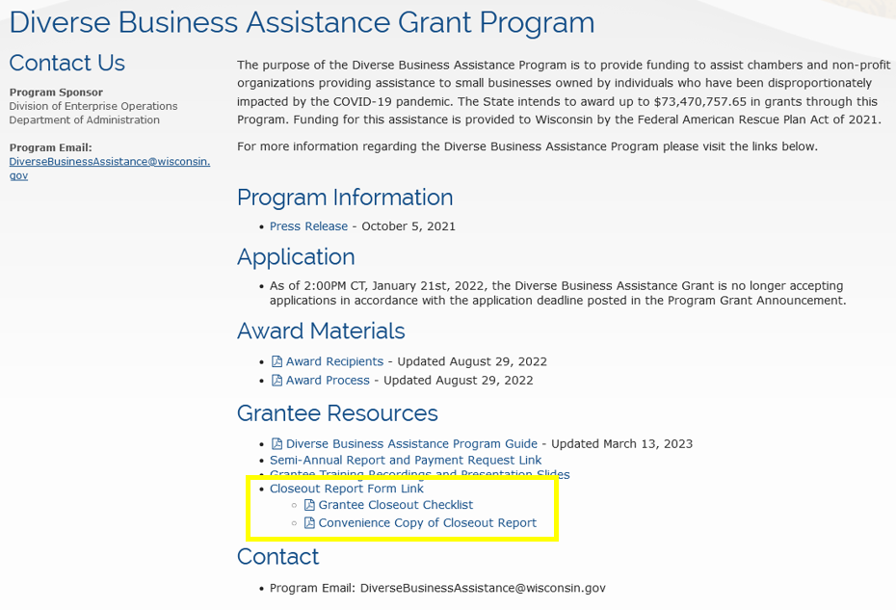
Checklist Overview
After submitting the final Semi-Annual Report and Payment Request form, grantees will receive an email with the checklist, a link to closeout form, and a link to the sample closeout report.
These resource documents are also located on each program page under ”Grantee Resources.”
DBA: https://doa.wi.gov/pages/DiverseBusinessAssistance.aspx
DBI: https://doa.wi.gov/pages/DiverseBusinessInvestment.aspx
ER: https://doa.wi.gov/pages/EquitableRecovery.aspx
HCI: https://doa.wi.gov/Pages/HealthcareInfrastructure.aspx
NIF: https://doa.wi.gov/Pages/NeighborhoodInvestment.aspx
TC: https://doa.wi.gov/Pages/TourismCapitalGrantProgram.aspx

Slide 9
Checklist Example
The ~2-page checklist provides guidelines of where to start preparing for the closeout process.
Minimal standards of what to has done at each point in the process:
3 months before
1 month before
At Closeout

Slide 10
Three months Before End of Period of Performance
Review grant agreement for goals and milestones
Are you on track to meet the completion date?
Are there outstanding action items?
Are subcontractors or partners missing deadlines?
Review financial information
Are expenditures allowable to the grant agreement/amendment(s)?
Have all funds been expended in each category?
Have any budget line items been exceeded?
Cost-sharing accounted for?
Do you need an amendment?
Amendments cannot be adopted during closeout.

Slide 11
Three Months, continued
Did you have a subawardee(s)?
Have their expenditures been documented?
Do you have a record for each business that received subaward funds (including street address, loan amount, date provided, etc.)?
Have they provided required items on time?
Have they completed all terms and conditions of their subaward?
For DBI & DBA grantees: Have you completed the Subaward addendum to the Semi-Annual Report and Payment Request?

Slide 12
Three Months, continued
Reflect on the audience and deliverables of the project
Have you documented the number of people/businesses/clients/etc., served?
Is any other quantitative information available to document your grant project’s impact?
Do you have rosters or attendance sheets for programming or training activities conducted using grant funds?
For construction, system implementation, and/or contract work projects:
When was the project complete or online?
For a construction project, when did it (or will it) be open?
Were there cost overruns or were contingency funds used?
Review acknowledgments made for the funding received
If you want to provide pictures of project activities, give permission in writing for photo usage by the state.

Slide 13
One Month
Have you submitted all documents requested by the program, including audit reports and requests for monitoring?
Reflect on the project and its impact:
Did you meet or exceed the goals of the project?
Did you miss any goals? If so, were you able to course-correct?
What was the impact of this program?
Have the funds led to any long-term changes in the way you operate or work?
Have the funds impacted your capacity to serve?
Is there numeric data to support the impact of the grant?
Are there other opportunities for measurement?
For DBI grantees: Are there any measures in the broader economic impact of the loans, grants, or technical assistance provided?

Slide 14
Amendments
It is important to request amendments as soon as possible.
Amendments cannot be approved during closeout.
Amendments may be denied, but it is important to communicate concerns or questions with program staff.
If you have funds that have not been expended at the end of the performance period, you must indicate this on the closeout form and notify Program Staff.
All unspent funds which were disbursed to the grantee must be returned to the state.
Maintain all documentation of expenses, including sub-awardee expenses, for 5 years post closeout.

Slide 15
Closeout Form

Slide 16
Section 1: DocuSign
Under Grantee, the person who is the point of contact for this organization should be submitting this form.
Provide your name and email address.
The program name and program email address will be prefilled.

Slide 17
DocuSign Login
If you would like a copy of this DocuSign document, provide contact info here. You can also designate another individual to receive a copy.
You will receive a courtesy copy when you submit the form and another once it is finalized by DOA.
Once complete, scroll down and select the yellow “Begin Signing” button.

Slide 18
DocuSign Disclosures
Prior to gaining access to the online DocuSign document, you will see this screen.
You do not need to accept any disclosures, but you should be aware that you can complete this form in multiple sittings by clicking the Finish later.
You must select “Continue” to access the form.

Slide 19
Section 1
This page is the same across all programs..
Section 1 contains:
Grantee name
Date of submission
Project ID (can be found on Grant Agreement, e.g., ARPA-DBA-###)
Contact person’s name, title, phone number, and email address
Note: Should the contact person change within the 5 years after the Grant closeout, this information should be updated with the Department.

Slide 20
Section 2: Reporting and Narrative Description of Activities: All Programs
All grantees will be required to answer several reporting questions.
There are also several narrative sections where grantees will provide details of their successes and accomplishments and also detail any obstacles encountered.

Slide 21
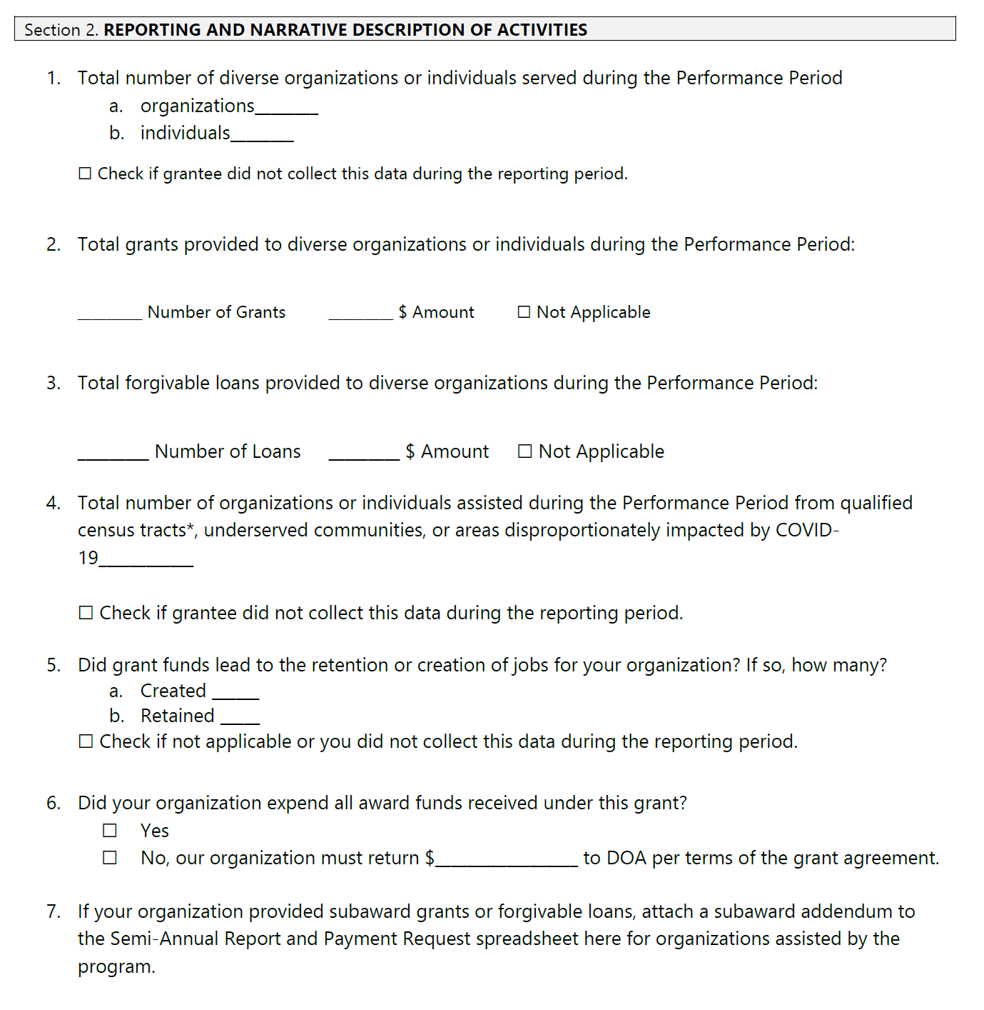
Section 2: Reporting and Narrative Description of Activities: All Programs
Did the funds lead to job retention or creation? List the amount.
Were all award funds expended? If not, how much will be returned to DOA per terms of Grant Agreement?
Additional questions are specific to each program; please consult the convenience copy to review program-specific questions.

Slide 22
Section 2: Reporting of Activities: Diverse Business Assistance & Investment
Number of diverse individuals or organizations (DBA) or diverse small businesses (DBI) served during the performance period.
Funds provided to diverse small businesses divided by number and amount of:
Grants
Forgivable Loans
Loans from Revolving Loan Fund (DBI Only)
Number assisted from qualified census tracts, underserved communities, or areas disproportionately impacted by COVID-19.
For Grantees with subaward grants or forgivable loans, attach to the closeout form a subaward addendum to the Semi-Annual Report and Payment Request spreadsheet for organizations assisted by the program.

Slide 23
Section 2: Reporting of Activities: Equitable Recovery
Select the Program category for which you received funding under your grant application. If you have grants from both, complete a separate closeout report for each.
Category A: Health and Early Childhood or Education (ERG1)
Category B: Economic Support, Housing, or Environmental Justice (ERG2)
Total number of individuals or organizations served during the Performance Period from qualified census tracts and/or disproportionately affected communities.
Individuals
Organizations
Was demographic information collected on the individuals your organization served? If yes, how many served met the following criteria:
Persons who identified as BIPOC (Black, Indigenous, People of Color)
Persons who identified as LGBTQ+
Persons who identified as Latino/a
Persons who identified as Veterans
Persons over the age of 65
Youth

Slide 24
Section 2: Reporting of Activities Healthcare Infrastructure & Tourism Capital
Total number of individuals served during the performance period.
Are all capital projects funded under this grant agreement completed? If not, list when the project will be completed.
Health Care Infrastructure: Total Number of individuals served during the performance period enrolled in Medicaid and/or Medicare, uninsured and underserved populations living in and/or working in qualified census tracts, or populations disproportionately impacted by COVID-19.
Tourism: Total Amount of tourism dollars and jobs created by the grant.

Slide 25
Section 2: Reporting of Activities: Neighborhood Investment
Was this project in or served a qualified census tract? If served, how many?
Select which Equity Gap the project addresses and describe how:
Economic and/or Workforce Development
Revitalization/Blight Elimination
Housing/Homelessness
Vulnerable Populations (Shelters, Aging Resources, Seniors, Individuals with disabilities, etc.)
Other
Total Number of underserved reached during the Performance Period
Individuals
Populations
Describe which populations (e.g., region, community…)
Housing Units created
Other (describe)
Are all capital projects funded under this grant agreement completed? If not, list when the project will be completed.

Slide 26
Narrative Sections

Slide 27
Narrative Sections
These sections provide an opportunity to tell the story of the impact of your grant and share your successes.
They can contain statistical information about programs but may also include anecdotal evidence or stories of individuals served.
These should NOT simply copy the Scope of Work or Semi-Annual Report, but should provide an accurate accounting of program outcomes.
Be specific in your comparison to the objectives of the scope of work.
Be thorough, but concise—4,000-character limit.
You will have the opportunity to attach supporting documentation or supplemental information if it will not fit within the character limit.

Slide 28
Narrative Sections
Accomplishments
COVID-19 Pandemic Recovery Impact
Challenges
Success Stories
(Optional)

Slide 29
Narrative Sections: Accomplishments
Grantees in all programs will be asked to itemize their accomplishments.
Provide details and statistics to show how well you have met the goals of your Scope of Work.
Be specific about the things that went well or better than expected.

Slide 30
Narrative Sections: COVID-19 Recovery Impact
Equitable Recovery: …Helped you provide services, programming, or build capacity to increase equity and eliminate disparities from the negative economic impacts of COVID-19 in economic, educational, health, housing, and/or environmental areas?
Health Care Infrastructure: …Helped your organization build additional capacity for care, increase access to healthcare for underserved communities, or increase the ability to respond to future public health emergencies?
Neighborhood Investment: …Helped you deliver public services to underserved individuals and populations in your community, including building new or improving facilities for housing, workforce development, or transit opportunities?
Tourism Capital: …Helped your organization bolster the Wisconsin tourism industry? How many tourism jobs created? Include how the tourism industry in your region benefitted from your specific activities.

Slide 31
Narrative Sections: Challenges
Grantees in all programs will be asked to identify any challenges they faced or had to overcome.
Be specific about these difficulties and how you were able to address them.
Be analytical about why these challenges were unique to your project.

Slide 32
Narrative Sections: Success Stories
Grantees in all programs will have the opportunity to share any success stories from their experience with the grant award.
While this section is optional, grantees are encouraged to use this space to tell their story.
This is a supplement to your Accomplishments; if you have outstanding stories to mention or particular narratives to highlight that cannot fit in that section, highlight them here.

Slide 33
Attaching Supplemental Documents
To attach supplemental items (including documents and images), look for Optional yellow paper clip icons.
You can find these paper clip icons at the end of the Section 2 (Narratives).

Slide 34
Narratives: Best Practices
Be specific
Brag about the work accomplished by the grant.
01
Use quotes, numerical data, and descriptions to weave a tale. For help getting started, use the courtesy copy of the closeout form provided to you by Program Staff.
02
Include images, if possible. Get written permission before using images (and keep those records).
Attach supplemental records if demonstrative.
03
Be mindful of the 4,000-character limit.
Provide examples.
Use MS Word to draft narrative.
04

Slide 35
Attestations
Important to read through these carefully.
Must be agreed to before submitting.
After the grant is closed out, you must continue to retain any records related to the program funded by ARPA for 5 years from the end of the performance period.
You are liable for the information contained within the Closeout form.

Slide 36
Attestations, continued
Information in your closeout report must be:
Accurate
Incurred by the grant receiving organization
Allowable expenses
Compliant with federal/state law and your grant agreement

Slide 37
Attestations, continued
Property bought by your grant cannot be sold or involved in any transaction without DOA consent.
Must keep records for five years to be compliant with ARPA.

Slide 38
Attestations, continued
Must submit final report form to fulfill grant agreement.
DOA can advertise your information submitted and you waive any claims.

Slide 39
Section 4
Cannot process request without a signature.
By signing, your organization acknowledges that it is adhering to the requirements imposed by the Federal government and DOA in order to access ARPA funding.
Signatory Signee needs to be an authorized representative signer for of the organization.

Slide 40
Download a Copy
As stated earlier, you will receive a courtesy copy of the report once you submit and finalized DocuSign documents may take time to complete.
Only once completed will your organization receive a signed copy if you elected to provide your contact information on the first page.
While you wait for the final copy, you can download a copy of what you have input into DocuSign using the Download button (shown by the black arrow on the image).

Slide 41
Closeout Best Practices

Slide 42
Closeout Responsibilities: Financial Closeout
Documents the project’s accomplishments
Identify:
Final payments
Unobligated balances
Disallowed costs
Outstanding financial obligation

Slide 43
Closeout Responsibilities: Property Disposition
Determine how to dispose of various types of property acquired for the award that are no longer needed that include the following:
Real Property
Equipment
Supplies
Intangible Property

Slide 44
Closeout Responsibilities: Reporting
Submit final closeout reports to DOA for the following:
Performance Measurement
Federal Financial
Tangible Personal Property
Real Property Status

Slide 45
Issues that Can Cause Delays
Efforts to closeout an award can be hindered by issues such as:
Audits in progress
Manual report reconciliation processes
Disconnect between grant management and payment system
Cost-sharing agreements

Slide 46
Issues that Can Cause Delays
Final indirect cost rate approvals
Delayed technical deliverables
Unavailability of key personnel to complete their part of the closeout process
Grant projects that require multi-jurisdictional review

Slide 47
Best Practice Strategies for Grant Closeout
Keep an Eye on the Timeframe and start the process early
Have a detailed plan for the closeout process
Consider adopting or developing a closeout checklist
Maintain, organize, and archive all project documents

Slide 48
Best Practice Strategies for Grant Closeout
Maintain consistency with what has already been reported
Discuss closeout with any subrecipients in advance
Maintain multi-level review process for the final report
Have a process for records retention

Slide 49
Closeout Questions
Have you retained the appropriate documentation from the start of the grant until now?
Are your program metrics accurate? Do they align with your narratives?
Did any funds go unspent?
Have sub-awardees submitted their reports to you?

Slide 50
Thank you!

