Slide 1
Entrepreneurship Partner Grant
FY25 Round 2 – Informational Webinar
01.06.25

Slide 2
Webinar Overview
This webinar will be recorded and made available on the Entrepreneurship Partner Grant program webpage
Please submit any questions you have in the “Q&A” box

Slide 3

Webinar Overview
EPG Program Overview
Application Process Overview
Important Dates
Questions

Slide 4
Program Overview

Slide 5
Program Overview
Programs aimed at fostering entrepreneurial community development, enhancing capacity, providing business financing, offering technical assistance, or supporting other similar entrepreneurial initiatives
Competitive grant program, with 2 rounds held each fiscal year
Applicants must be a non-profit
  This includes municipalities and governments, Tribal entities, educational institutions, and community development organizations
  Fiscal sponsorships are allowed
  For-profit, businesses are not eligible to apply
1:1 matching funds
  Matching funds can be cash or in-kind
Maximum award amount is $200,000
Eligible costs include operational and implementation costs
Programs should be around 12 months in duration
Performance reports are due annually
  A Schedule of Expenditures will be required for awards over $100,000

Slide 6
Evaluation Criteria
Project Alignment and Feasibility:
The extent to which the work plan is feasible including project range, duration, and impact.
The extent to which the applicant and project collaborators may have relevant experience and historical performance in program administration including previous WEDC awards, if applicable.
Financial Viability:
The extent to which the project budget supports entrepreneurs compared to supporting operations as it relates to the overall intensity, duration or rigor of the project.
Outcome and Impact:
The extent to which the applicant demonstrates a unique position to meet community need for the target population or location.
Innovation and Sustainability:
The extent to which the program model can be replicated and/or sustained in other areas of Wisconsin.
Additional Considerations:
Presence of partnering and collaborating organizations and extent of community support.
Use of novel and innovative approach to supporting individuals and/or companies.
Alignment to WEDC priorities for industry sectors, local economic factors, geography, and target populations.
ROUND 2 ONLY: Applicants should demonstrate how their project introduces a new program or partnership with WEDC to expand high-quality entrepreneurial support, with a focus on underrepresented areas, rural communities, and reaching underserved founder populations, including veteran- or BIPOC- or women-owned startups.

Slide 7
Strategic Focus Round
Applicants should demonstrate how their project introduces a new program or partnership with WEDC to expand high-quality entrepreneurial support, with a focus on underrepresented areas, rural communities, and reaching underserved founder populations, including veteran- or BIPOC- or women-owned startups.
Additional Evaluation Criteria:
  The extent to which the proposal involves a new partner and/or introduces a novel pilot program designed to fill identified gaps in Wisconsin’s entrepreneurial support network. Applicants that bring forward new or novel program models, or propose unique collaborations not previously funded, will be scored higher in this category.
  The extent to which the proposal serves underserved founder populations, including socially and economically disadvantaged individuals. Priority will be given to applications that support organizations operating in rural communities, smaller cities, or emerging entrepreneurial hubs that have historically received less support, ensuring an equitable distribution of resources statewide.
Definitions:
  ‘New partners’ are defined as organizations that have not received an Entrepreneurship Partner Grant award in FY22 or after.
  ‘New programs’ are initiatives that have not been previously implemented or funded. These programs introduce novel approaches, services, or models that are distinct from any existing offerings and are designed to address unmet needs or gaps within the entrepreneurial ecosystem. They may involve new strategies, target populations, or operational frameworks, and are intended to create a meaningful impact in areas that have not been previously covered by similar programs
  ‘Socially and Economically Disadvantaged Individuals’ are defined as by the U.S. Department of Treasury.

Slide 8
Application Overview

Slide 9
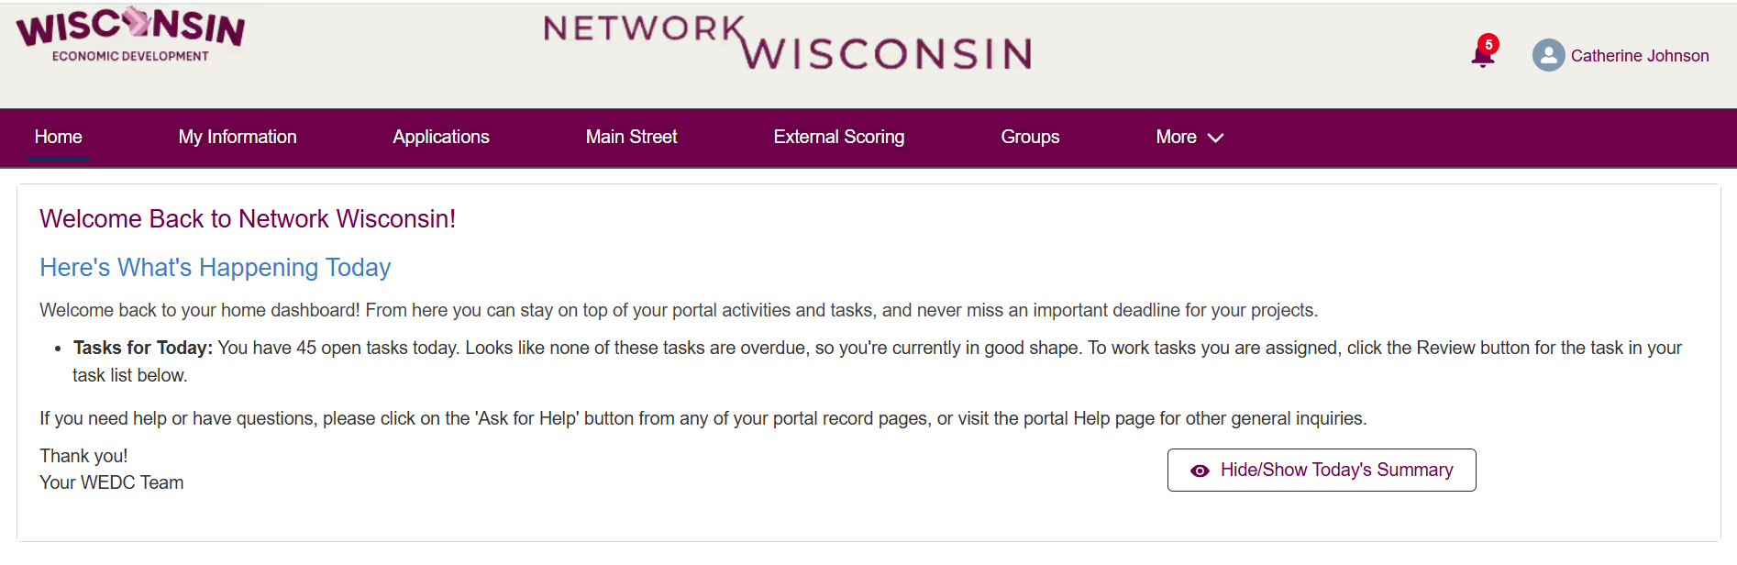
Network Wisconsin

Slide 10
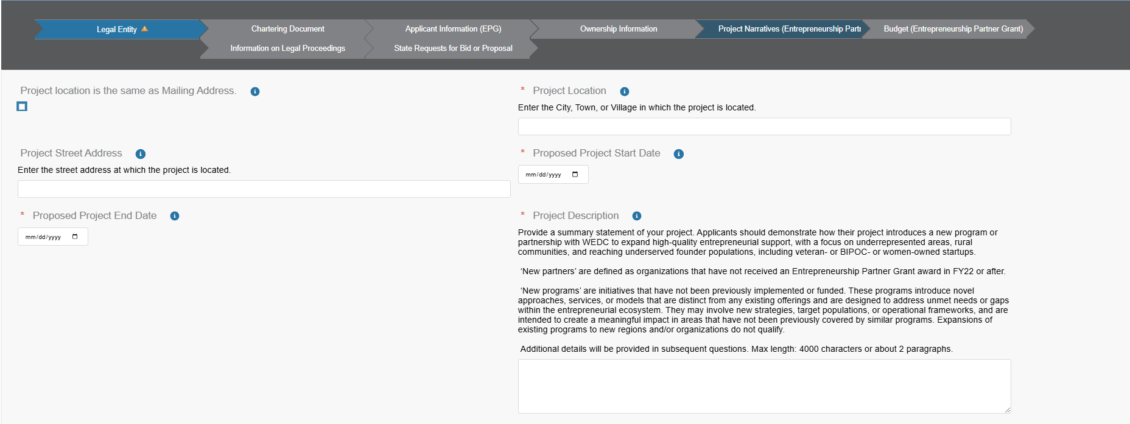
Project Narratives

Slide 11
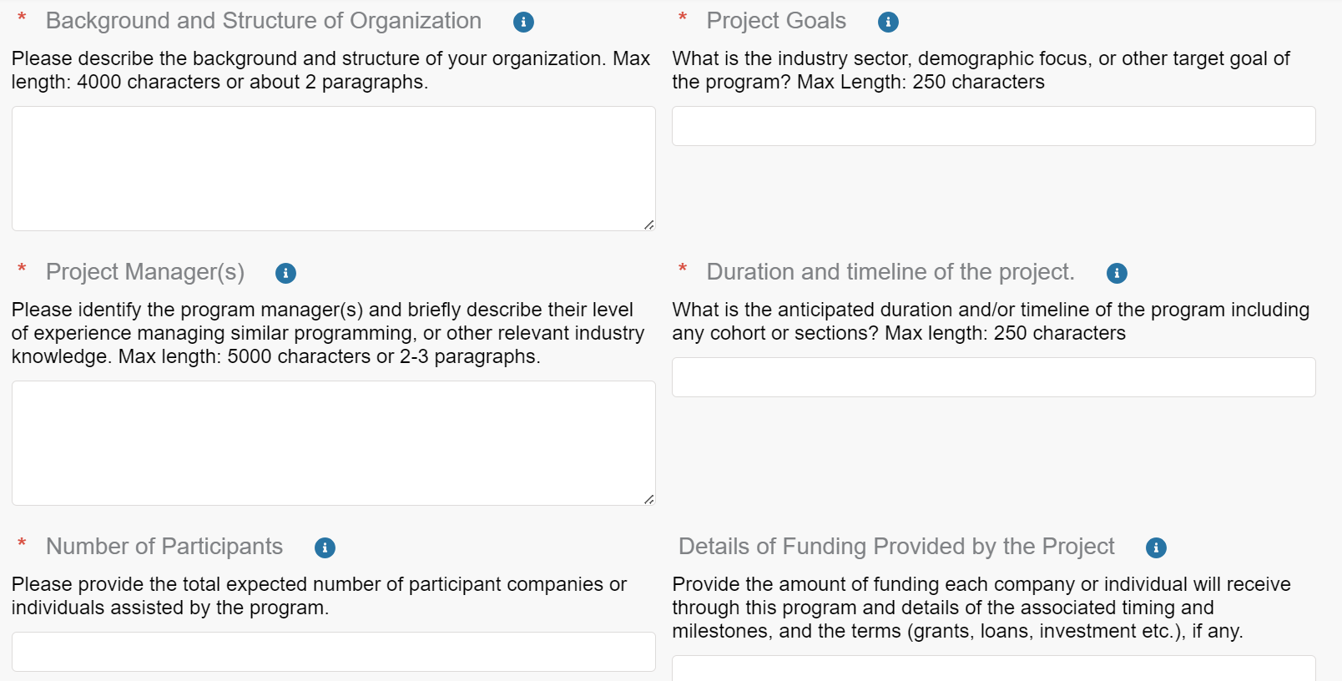
Continued

Slide 12
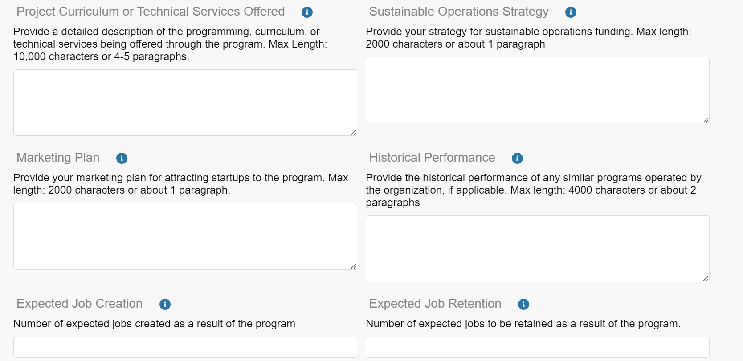
Continued

Slide 13
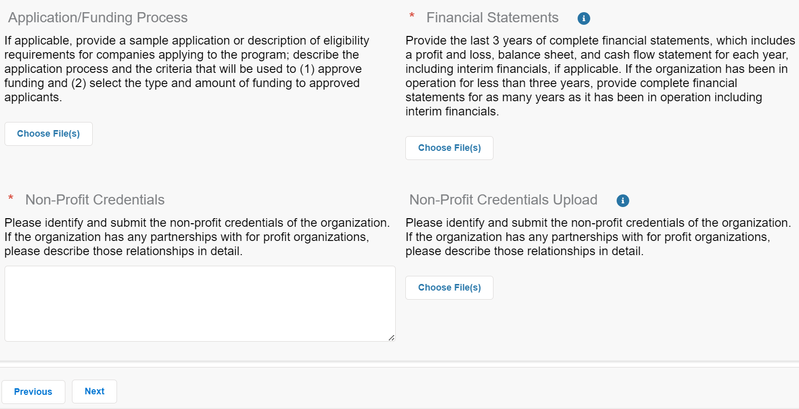
Continued

Slide 14
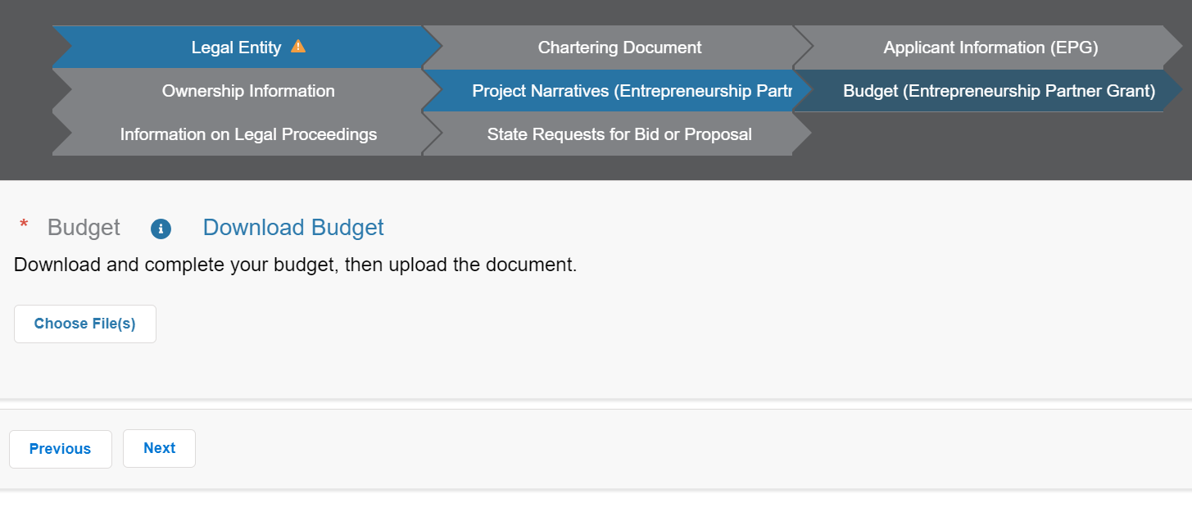
Budget

Slide 15
Application Materials - Budget
Expenses/Uses of Funding
Sources and Amounts of Funding
  WEDC Amount (Amount org is requesting from WEDC)
  Match Source Name
  Match Source Amount
  Cash or In-kind Match
  Total Budget

Slide 16
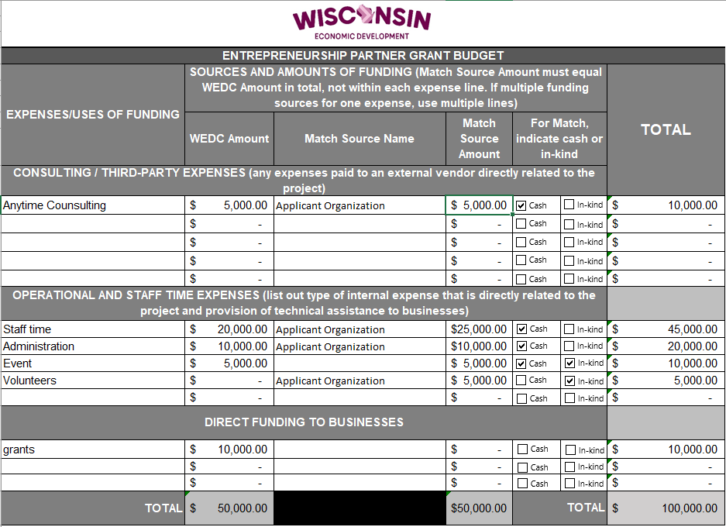
Application Materials – Budget Template

Slide 17
How to Apply
Step 1: Request an Application
  Email an E&I team member with your written express to apply for the Entrepreneurship Partner Grant. Please be sure to include who the best contact is to receive the application.
Step 2: Access your Network Wisconsin account
  You will receive an email notification from Network Wisconsin, inviting you to complete the EPG application.
  You can add collaborators in Network Wisconsin to the application to help complete sections.
Step 3: Complete your Application
  Login to Network Wisconsin and complete each section and upload any required documents.
Step 4: Submit your application!

Slide 18




Important Dates
Applications Open
Monday, January 6th at 8:00 am CDT
Office Hours
Session 1: Thursday, January 16th
Session 2: Wednesday, January 29th
Applications Close
Friday, January 31st at 11:59 CDT

Slide 19
Webinar Reminders
A recording of the webinar will be made available on the Entrepreneurship Partner Grant program webpage
Additional resources are also available on the webpage: FAQs, Program Guidelines, Evaluation Criteria

Slide 20
Questions?

Slide 21
Contacts
Ed Javier, Director of Entrepreneurship Advancement
ed.javier@wedc.org
Nichole Crust, Director of Entrepreneurship Access & Inclusion
nichole.crust@wedc.org
Cat Johnson, Entrepreneurship & Innovation Specialist
catherine.johnson@wedc.org

