Slide 1
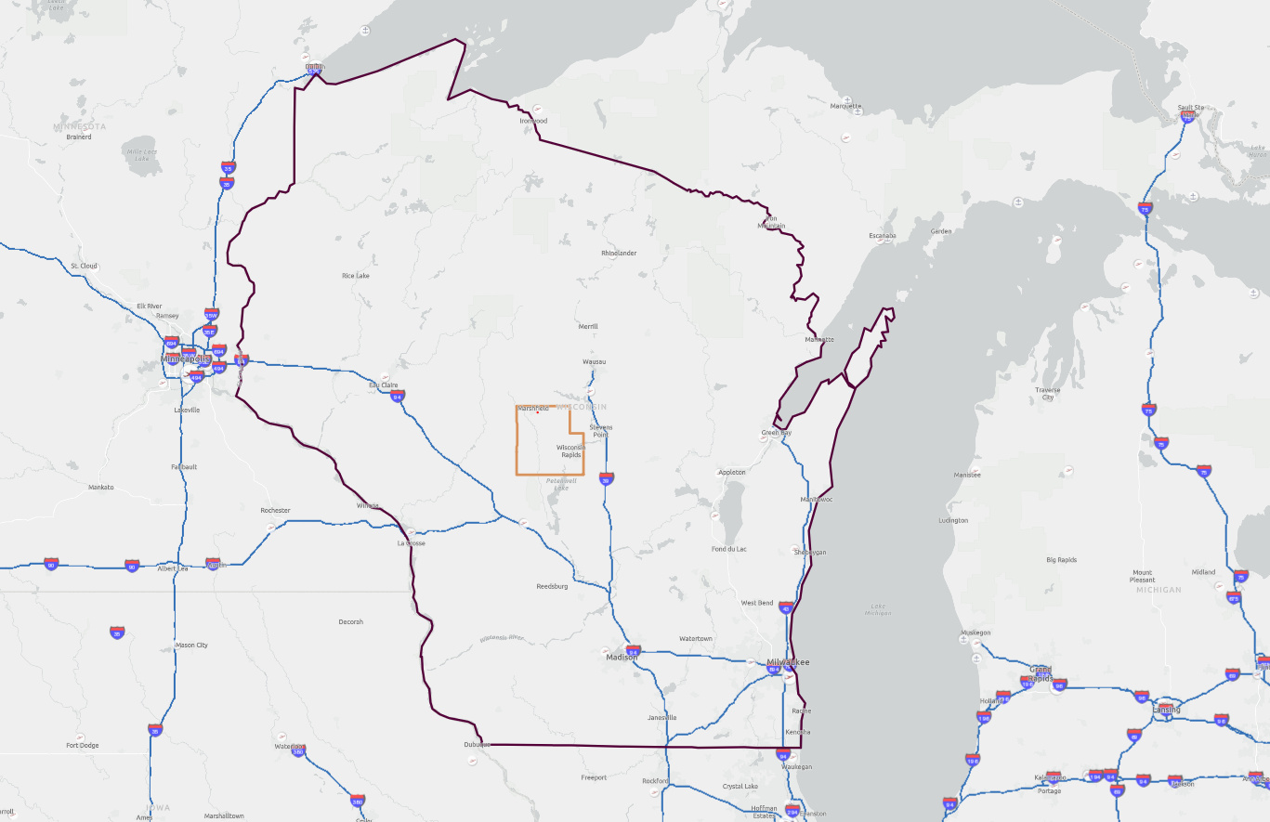
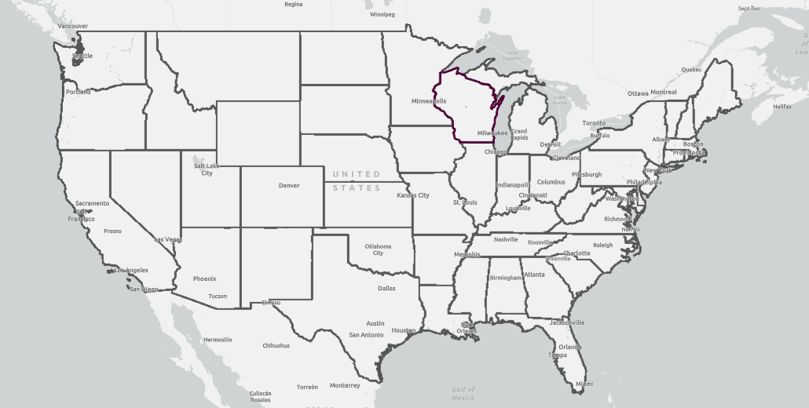
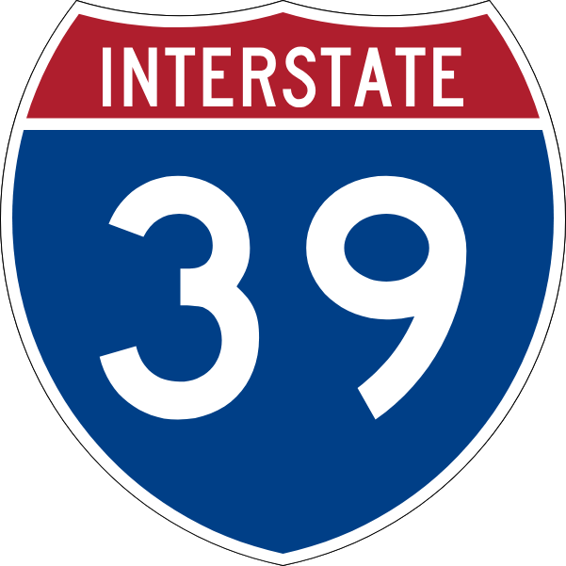
Yellowstone Industrial Park
Marshfield, Wood County, Wisconsin; Coordinates: 44.6445, -90.1305
General Location Map
145 acres
N
Legend
Site Location
Wood County
State of Wisconsin
Interstates
0
50
100
Miles
Source: ESRI – October 2022
Map Prepared: September 2024

Slide 2
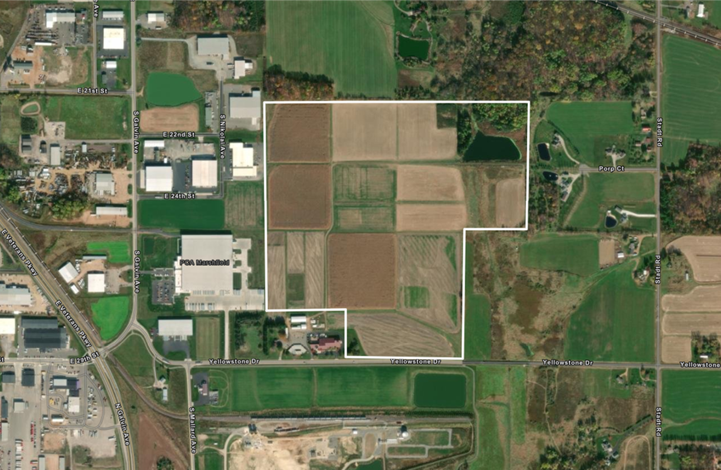
Yellowstone Industrial Park
Marshfield, Wood County, Wisconsin; Coordinates: 44.6445, -90.1305
Satellite Aerial Imagery
145 acres
N
Legend
Site Boundary
Source: ESRI – October 2022
Map Prepared: September 2024

Slide 3
Yellowstone Industrial Park
Marshfield, Wood County, Wisconsin; Coordinates: 44.6445, -90.1305
USGS Historical Map
145 acres
N
Legend
Site Boundary
Source: U.S. Geological Survey
Map Prepared: September 2024

Slide 4
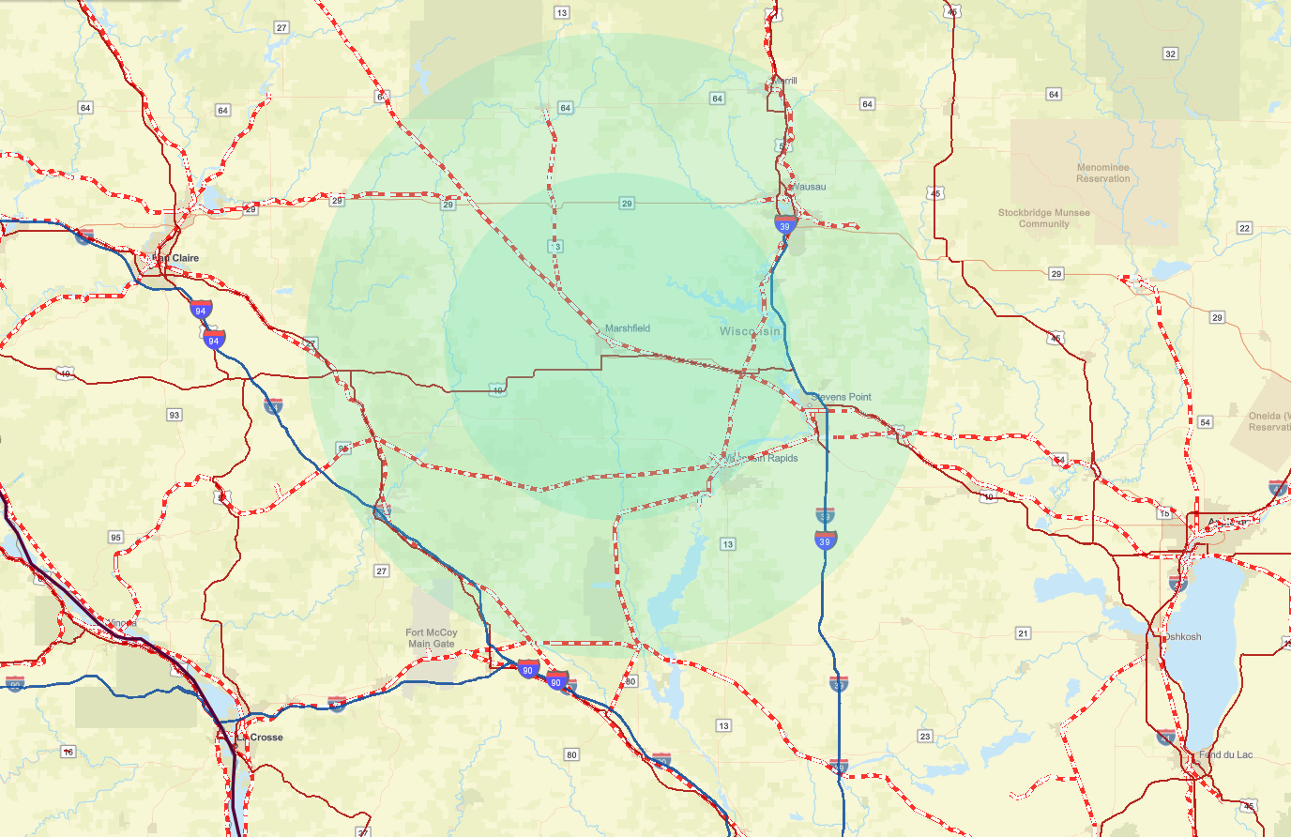
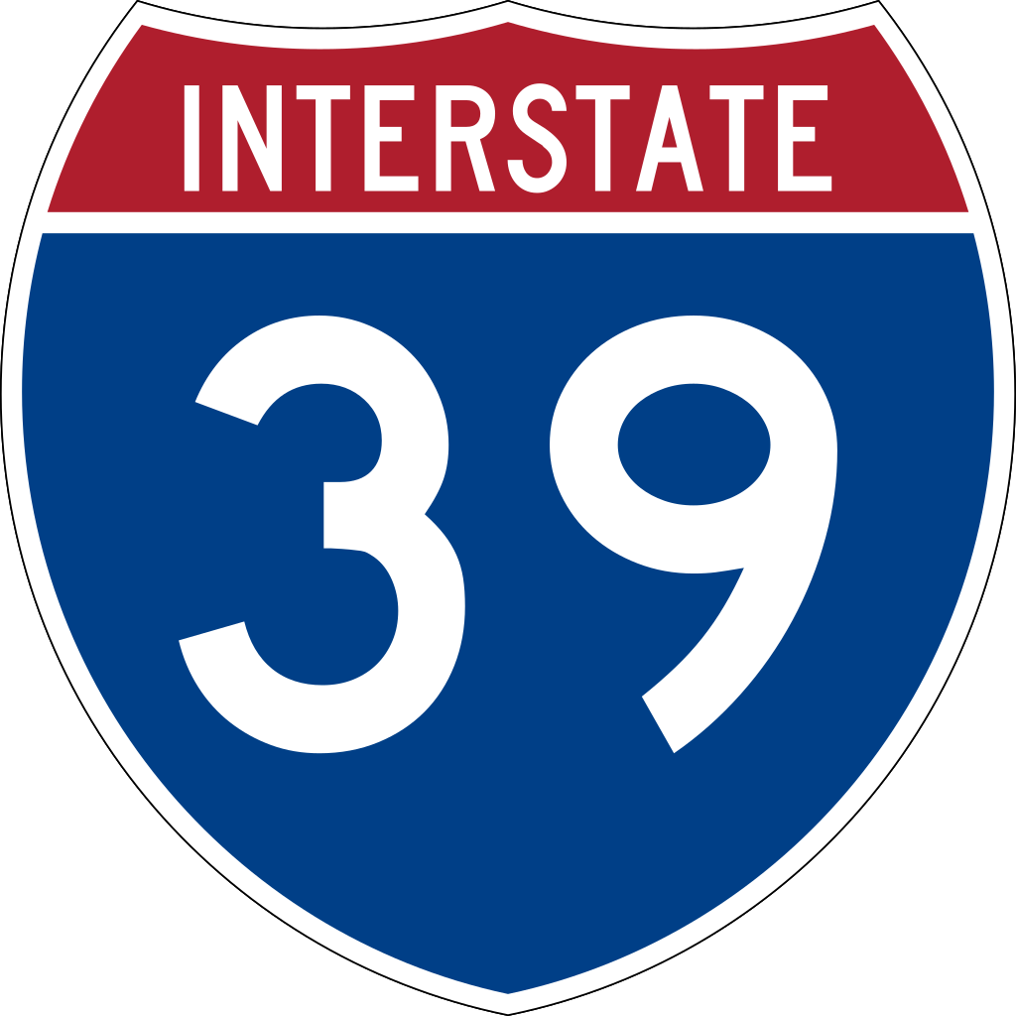
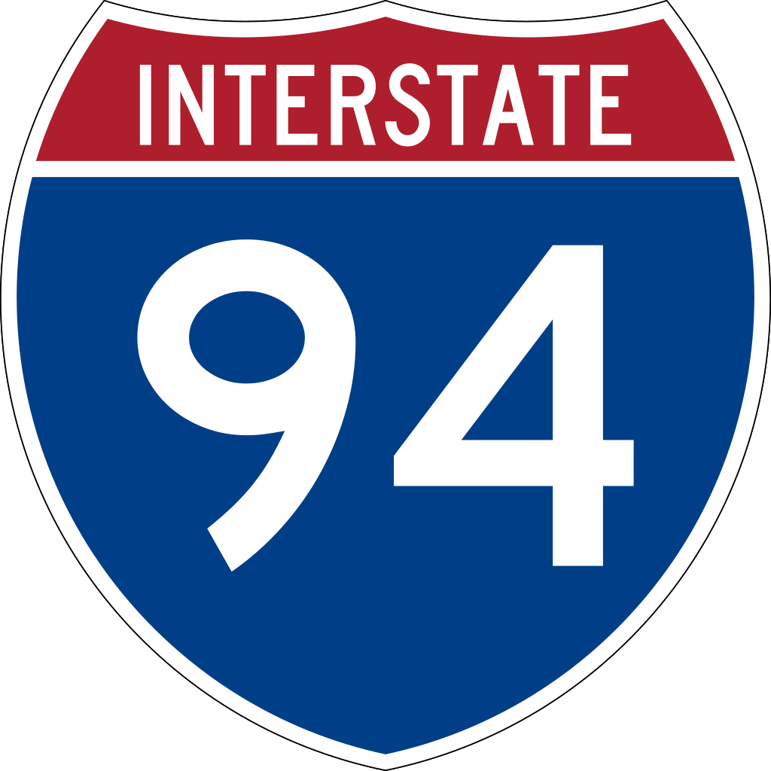
Yellowstone Industrial Park
Marshfield, Wood County, Wisconsin; Coordinates: 44.6445, -90.1305
General Transportation Map
145 acres
0
20
40
45 miles
N
20 miles
Eau Claire
Site Location
Appleton
Legend
Central Wisconsin Airport (38 miles from the site)
Chippewa Valley Regional Airport
Interstate 39
(28 miles from the site)
Railroad (potential rail service by Canadian National “CN”)
Source: Latapult & Google Maps
Route to I-39 from Yellowstone Industrial Park
Map Prepared: September 2024

Slide 5
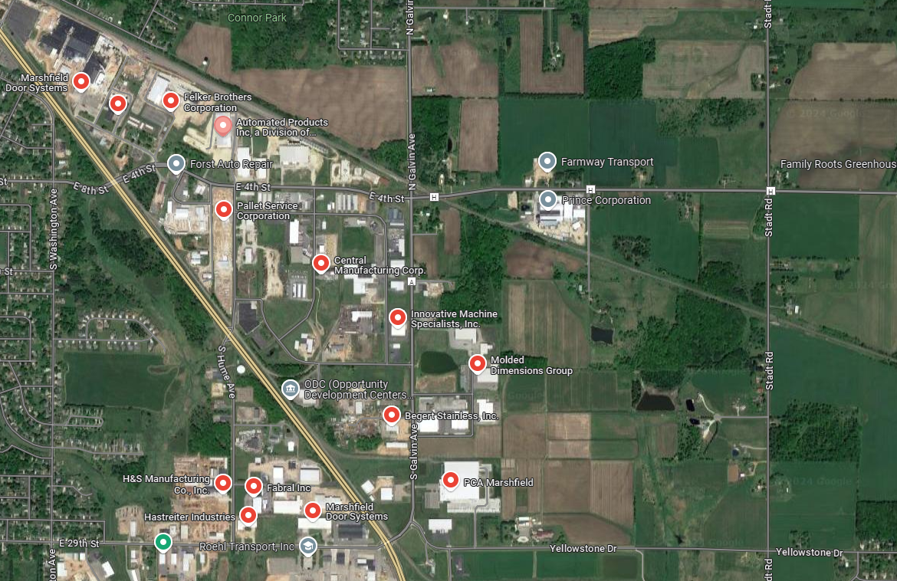
Yellowstone Industrial Park
Marshfield, Wood County, Wisconsin; Coordinates: 44.6445, -90.1305
Nearby Businesses Map
145 acres
Residential
N
Agriculture
Residential
Legend
Site Boundary
Nearby Manufacturers
Source: Google Maps 2022
Map Prepared: September 2024

Slide 6
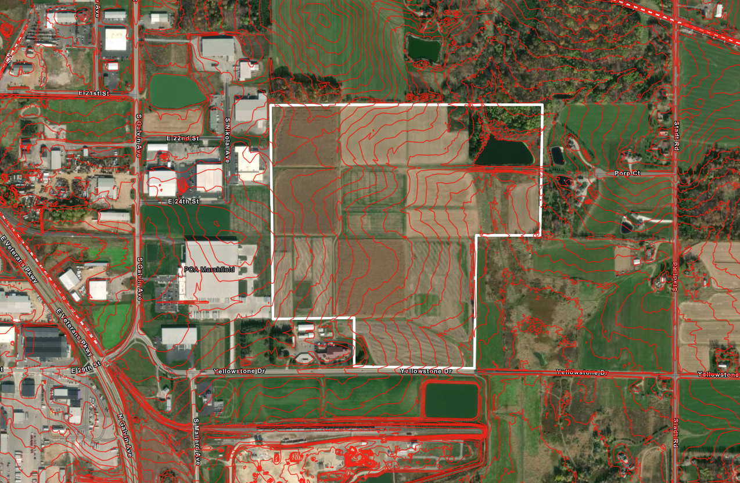
Yellowstone Industrial Park
Marshfield, Wood County, Wisconsin; Coordinates: 44.6445, -90.1305
Topographic Map
145 acres
N
Legend
Site Boundary
2-foot intervals
Source: Latapult 2024
Map Prepared: September 2024

Slide 7
Yellowstone Industrial Park
Marshfield, Wood County, Wisconsin; Coordinates: 44.6445, -90.1305
Tax Parcel Map
145 acres
N
Legend
Site Boundary
Parcel Lines
Source: Latapult 2024
Map Prepared: September 2024

Slide 8
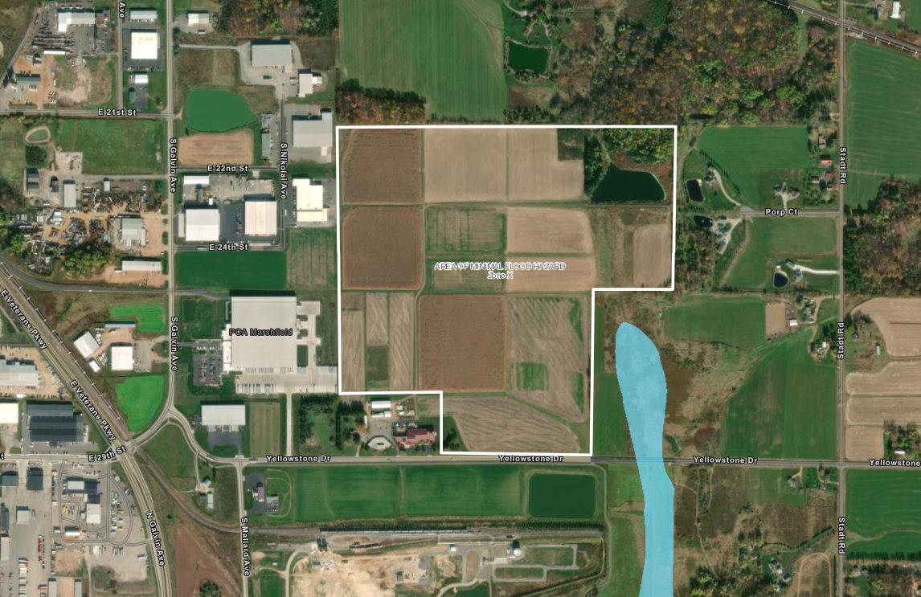
Yellowstone Industrial Park
Marshfield, Wood County, Wisconsin; Coordinates: 44.6445, -90.1305
FEMA Flood Map
145 acres
N
Legend
Site Boundary
1% Annual Chance Flood Hazard
0.2% Annual Chance Flood Hazard
Regulatory Floodway
Area with Reduced Risk Due to Levee
Source: FEMA Panel 55141C0045CG
Map Prepared: September 2024

Slide 9
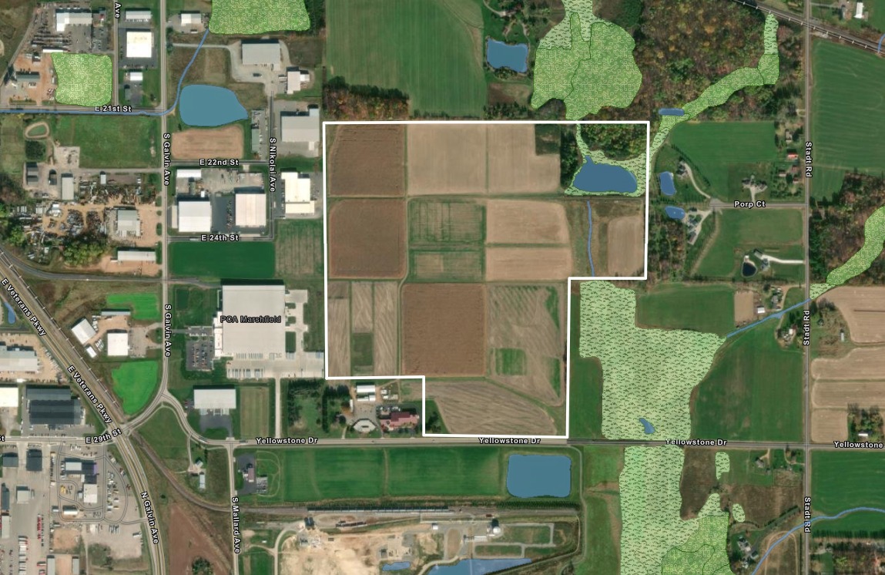
Yellowstone Industrial Park
Marshfield, Wood County, Wisconsin; Coordinates: 44.6445, -90.1305
National Wetlands Inventory Map
145 acres
N
Legend
Site Boundary
Forested Wetland
Non-Forested Wetland
Salt Marsh
Water
Source: National Wetland Inventory
Map Prepared: September 2024

Slide 10
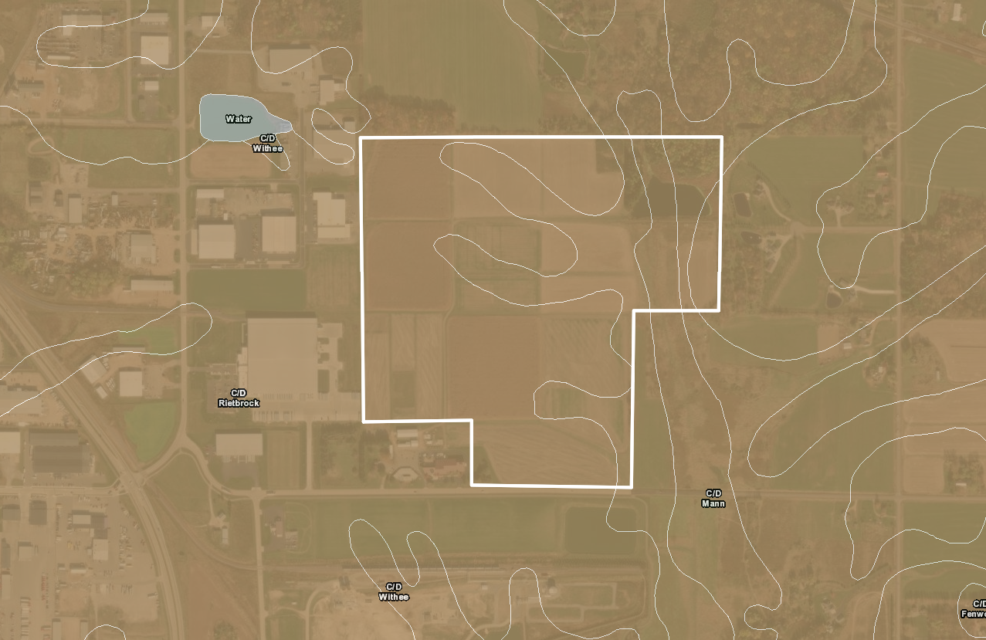
Yellowstone Industrial Park
Marshfield, Wood County, Wisconsin; Coordinates: 44.6445, -90.1305
County Soil Survey
145 acres
N
Legend
Site Boundary
Class A Soils
Class A/D Soils
Class B Soils
Class B/D Soils
Class C Soils
Class C/D Soils
Class D Soils
Not Classified
Source: US Soil Survey Geographic Data
Map Prepared: September 2024

Slide 11
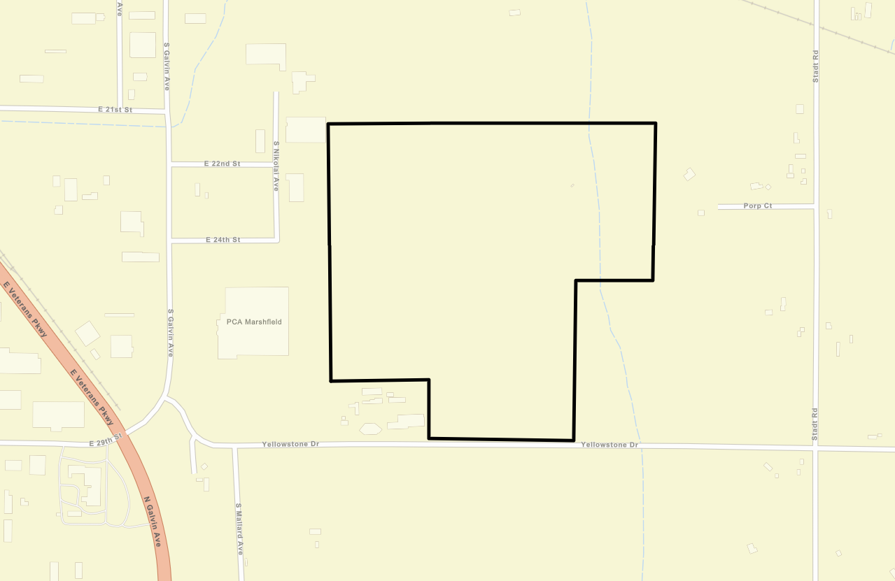
Yellowstone Industrial Park
Marshfield, Wood County, Wisconsin; Coordinates: 44.6445, -90.1305
Road Access Map
145 acres
N
East 22nd St
S Nikolai Ave
East 24th St
S Gavin Ave
Legend
Site Boundary
Yellowstone Drive
Yellowstone Drive
Proposed Road Extension
Feet
Source: Latapult 2024
Map Prepared: September 2024

Slide 12
Yellowstone Industrial Park
Marshfield, Wood County, Wisconsin; Coordinates: 44.6445, -90.1305
Route To Interstate Map
145 acres
0
20
40
45 miles
N
20 miles
Eau Claire
Site Location
Appleton
Legend
Central Wisconsin Airport (38 miles from the site)
Chippewa Valley Regional Airport
Interstate 39
(28 miles from the site)
Railroad (potential rail service by Canadian National “CN”)
Source: Latapult & Google Maps
Route to I-39 from Yellowstone Industrial Park
Map Prepared: September 2024

Slide 13
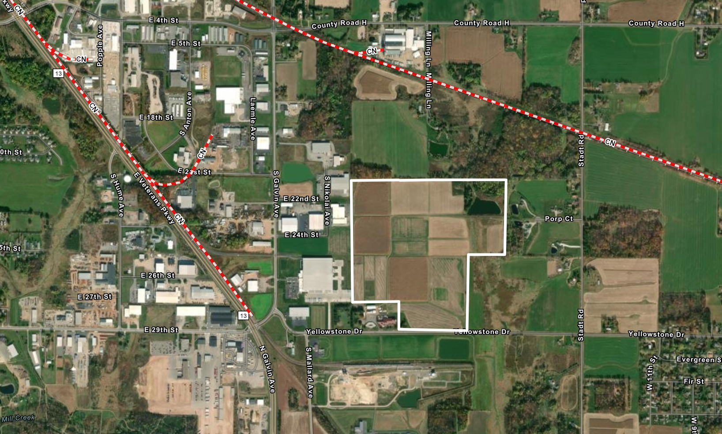
Yellowstone Industrial Park
Marshfield, Wood County, Wisconsin; Coordinates: 44.6445, -90.1305
Rail Infrastructure Map
145 acres
N
Legend
Site Boundary
Canadian National (CN) Railway
Proposed extension of rail spur
Source: Latapult 2024
Map Prepared: September 2024

Slide 14
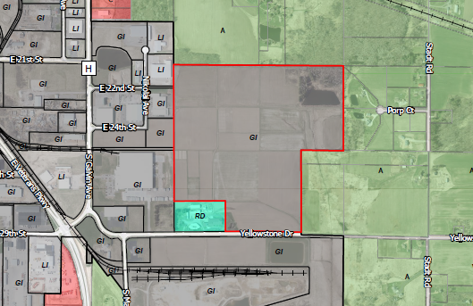
Yellowstone Industrial Park
Marshfield, Wood County, Wisconsin; Coordinates: 44.6445, -90.1305
Zoning Map
145 acres
N
Legend
Site Boundary
Industrial, City of Marshfield
R&D, City of Marshfield
Agricultural, Town of Marshfield
Commercial, Town of Cameron
Feet
Source: Wood County ESRI GIS
Map Prepared: September 2024

Slide 15
Yellowstone Industrial Park
Marshfield, Wood County, Wisconsin; Coordinates: 44.6445, -90.1305
Master Utility Infrastructure Map
145 acres
N
Legend
Site Boundary
7.2/13.2 kV Marshfield Utilities electric line
8-inch We Energies Natural Gas Line
12-inch Marshfield Utilities Water Line
18-inch Marshfield Utilities Wastewater Line
Fiber Line
0
750
1,500
Feet
Source: Utility Providers
Map Prepared: September 2024

Slide 16
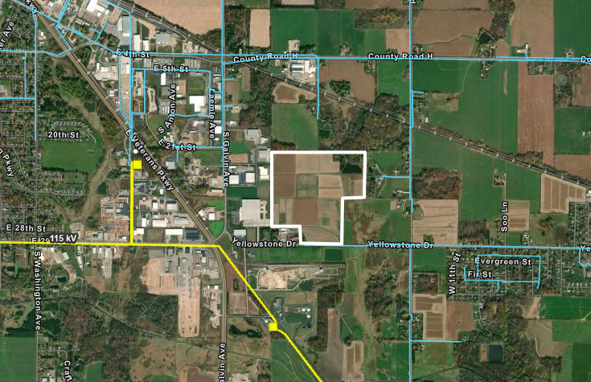
Yellowstone Industrial Park
Marshfield, Wood County, Wisconsin; Coordinates: 44.6445, -90.1305
Electric Utility Infrastructure Map
145 acres
N
13.2kV
13.2kV
Substation
115kv
Legend
Site Boundary
115kv
7.2/13.2 kV Marshfield Utilities electric line
Substation
Proposed extension for distribution service
115 kV Marshfield Utilities electric line
Marshfield Utilities Substation
0
1,750
3,500
Feet
Source: Utility Providers
Map Prepared: September 2024

Slide 17
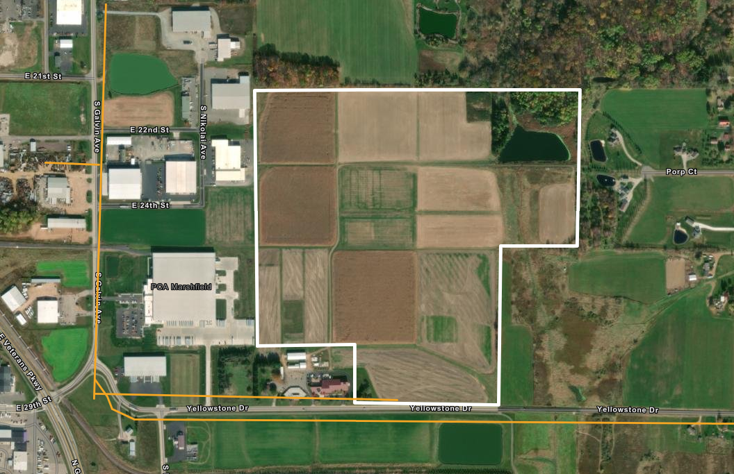
Yellowstone Industrial Park
Marshfield, Wood County, Wisconsin; Coordinates: 44.6445, -90.1305
Natural Gas Utility Infrastructure Map
145 acres
8 -inch [line type]
N
Legend
Site Boundary
8-inch We Energies Natural Gas Line operating at 20 – 60 psig
8-inch [line type]
Proposed extension of natural gas line
0
750
1,500
Feet
Source: Utility Providers
Map Prepared: September 2024

Slide 18
Yellowstone Industrial Park
Marshfield, Wood County, Wisconsin; Coordinates: 44.6445, -90.1305
Water Utility Infrastructure Map
145 acres
12-inch
N
Legend
Site Boundary
12-inch Marshfield Utilities Water Line
12-inch
Proposed extension of water line
0
750
1,500
Feet
Feet
Source: Utility Providers
Map Prepared: September 2024

Slide 19
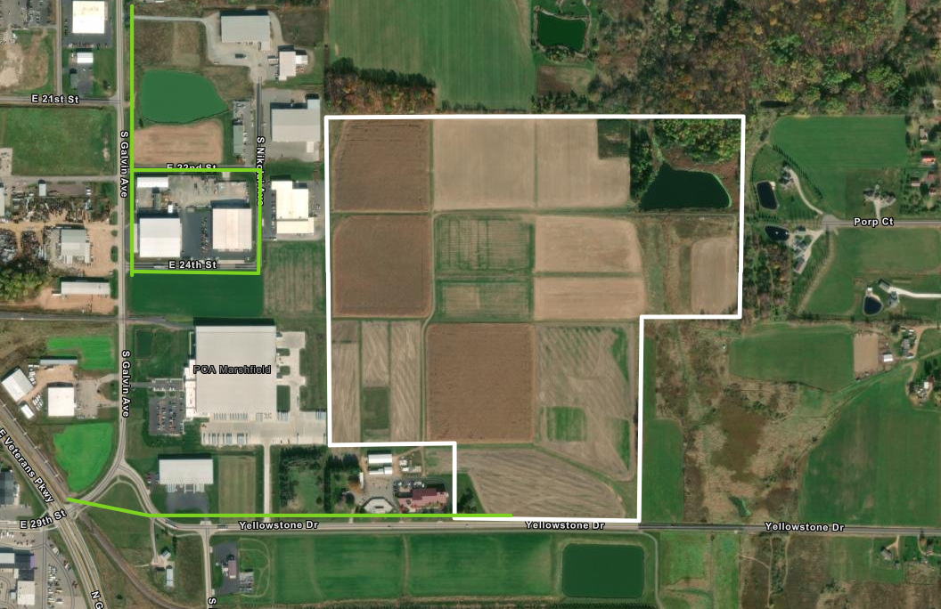
Yellowstone Industrial Park
Marshfield, Wood County, Wisconsin; Coordinates: 44.6445, -90.1305
Wastewater Utility Infrastructure Map
145 acres
18-inch [gravity]
N
Legend
Site Boundary
18-inch Marshfield Utilities Wastewater Gravity Main
18-inch [gravity]
Proposed extension of wastewater line
0
750
1,500
Feet
Source: Utility Providers
Map Prepared: September 2024

Slide 20
Yellowstone Industrial Park
Marshfield, Wood County, Wisconsin; Coordinates: 44.6445, -90.1305
Telecom Infrastructure Map
145 acres
[Provider Name] & [Capacity]
N
Legend
[Provider Name] & [Capacity]
Site Boundary
Fiber
Proposed extension of Fiber within park
0
750
1,500
Feet
Source: Utility Providers
Map Prepared: September 2024

Slide 21
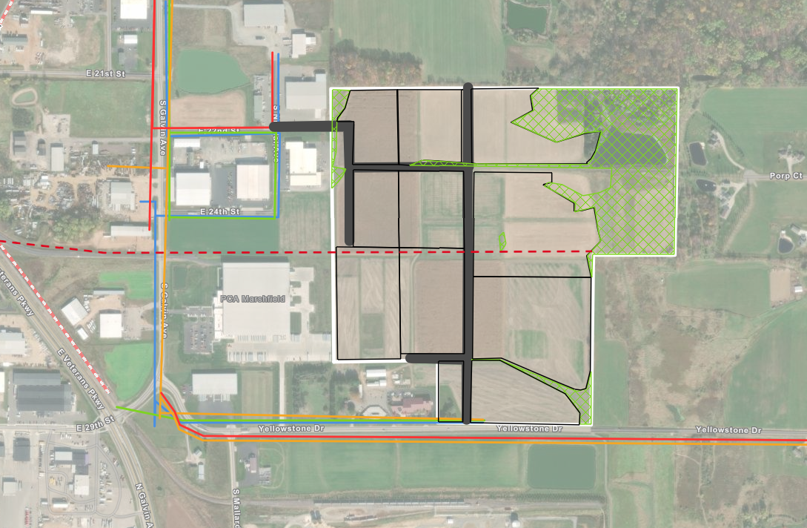
Yellowstone Industrial Park
Marshfield, Wood County, Wisconsin; Coordinates: 44.6445, -90.1305
Master Conceptual Plan
145 acres
Proposed road and utility ROW
N
Lot A:
7 acres
Lot B:
9 acres
Lot C:
11 acres
wetlands
Lot D:
7 acres
Lot E:
9 acres
Lot F:
21 acres
Legend
Site Boundary
(~123 developable acres)
Lot G:
13 acres
Lot H:
13 acres
Wetland Areas (2020 Wetland Delineation)
Proposed Rail spur ROW
Lot I:
21 acres
Proposed road and utility ROW
Existing rail
Proposed rail spur
Lot J:
3 acres
Lot K:
9 acres
7.2/13.2 kV Existing electric line
Proposed electric distribution line
8-inch Existing Natural Gas Line
Proposed Natural Gas Extension
12-inch Existing Water Line
Proposed Water Line
Total Lot acreage: | 123
Developable acreage | 123
Total acreage | 145
18-inch Existing Wastewater Line
Proposed Wastewater Line
0
750
1,500
Existing Fiber line
Feet
Proposed Fiber line
Map Prepared: September 2024
Source: ESRI – October 2022

